Slide 1
Computer Architecture
Atul Kahate

Slide 2
Basics and History

Slide 3
Computer Organization and Architecture
Computer organization: Physical aspects of a computer system (e.g. circuit design, control signals, memory types)
Computer architecture: Logical aspects of a computer as seen by a programmer (e.g. instruction sets, instruction formats, data types)

Slide 4
Organization Architecture
Also called microarchitecture or low level architecture
Transparent to the programmer (e.g. a programmer does not need to know how an addition operation is performed by the hardware)
Deals with physical components
How to do (Implementation)
High-level architecture
Programmer has to be aware of the instructions that are used
Deals with logical components (instruction set, addressing mode, data types)
What to do (Instruction set)

Slide 5
Brief History of Computers
Generation | Time Period | Details
0th (Mechanical computers) | 1642-1945 | Mechanical devices (e.g. Difference Engine and Analytical Engine of Charles Babbage) – See next slide Konrad Zuse’s calculating machines using electric relays John Atanasoff’s calculator
1st (Vacuum tubes) | 1945-1955 | COLOSSUS in England (Alan Turing), ENIAC (Mauchley and Eckert)
2nd (Transistors) | 1955-1965 | Digital Equipment Corporation (DEC) PDP-1, CDC 6600, Cray Supercomputers
3rd (Integrated Circuits or ICs) | 1965-1980 | IBM System/360 series of computers – Same assembly language, multiple computers, introduced multiprogramming,
4th (Very Large Scale Integration or VLSI) | 1980-Ongoing | IBM and other ‘cloned’ Personal Computers (PC), Apple Macintosh, CP/M and DOS operating systems, Intel 80836 chip in 1985 (x86)
5th (Low power and invisible computers) | 1990s onwards | PDAs, Smart phones, IoT

Slide 6
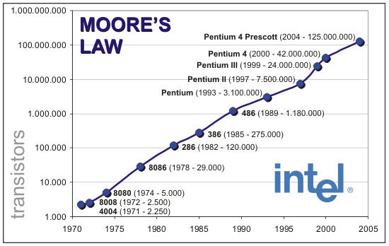
Computer Performance – Moore’s Law

Slide 7
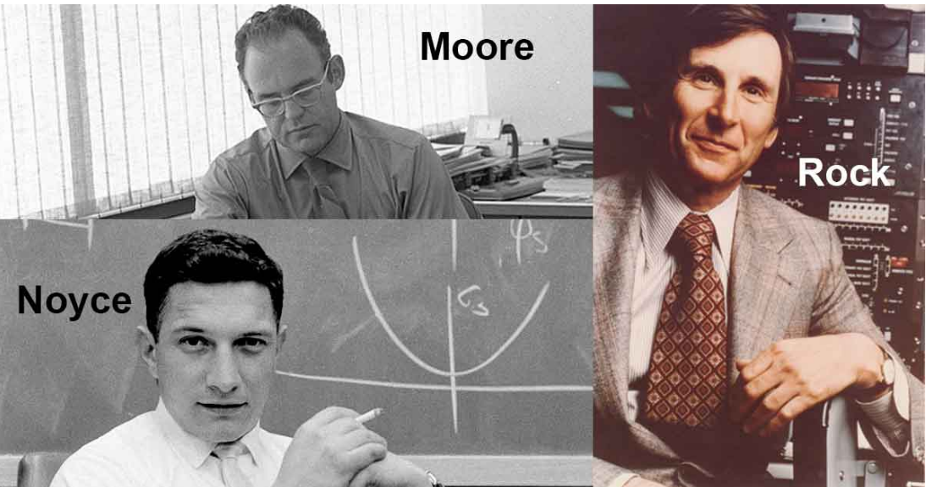
Intel x86 Architecture – The start
In 1968, Intel Corporation was formed by three people to make memory chips

Slide 8
Intel x86 Architecture – CPU-related Work
In the late 1960s, calculators were large electromechanical machines weighing 20 kg
In 1969, a Japanese company, Busicom, approached Intel with a request to manufacture 12 custom chips for a proposed electronic calculator
The Intel engineer assigned to this project, Ted Hoff, looked at the plan and realized that he could put a 4-bit general-purpose CPU on a single chip that would do the same thing and be simpler and cheaper as well
Thus, in 1970, the first single-chip CPU, the 2300-transistor 4004, was born
4-bit processor means its data bus is made up of 4-bits, so it can transfer 4 bits of data at a time

Slide 9
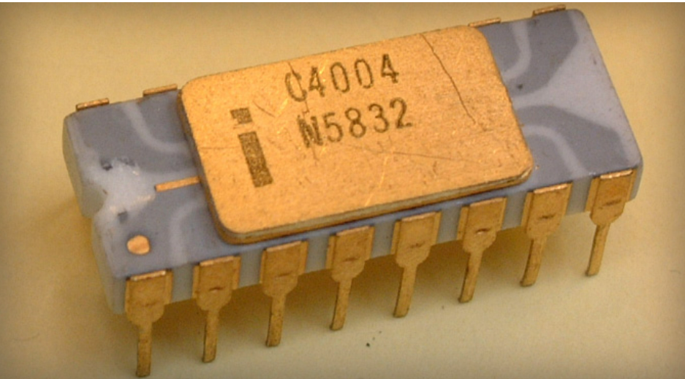
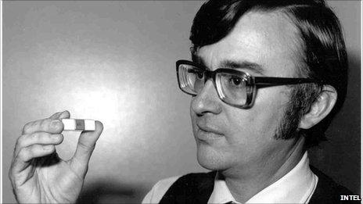
Intel x86 Architecture – CPU-related Work
Ted Hoff and the 4004 chip

Slide 10
Intel x86 Architecture – 8080
Intel bought back all the rights to the new chip from Busicom by returning the $60,000 Busicom had paid Intel to develop it
Intel started working on an 8-bit version of the chip, the 8008, introduced in 1972
Next, it created 8080, a small, general-purpose CPU, introduced in 1974
Intel sold millions of these chips

Slide 11
Intel x86 Architecture – x86
1978: 8086 – A 16-bit chip
The next logical step was a true 32-bit CPU on a chip, the 80386, brought out in 1985 (called x86 now) – Data and address bus each of 32 bits
Then came 80486
At this point, Intel found out the hard way (by losing a trademark infringement lawsuit) that numbers (like 80486) cannot be trademarked, so the next generation got a name: Pentium
In 2006, Intel changed the brand name from Pentium to Core and released a dual core chip, the Core 2 duo (Dual core is a CPU that has two distinct processors that work simultaneously in the same integrated circuit)

Slide 12
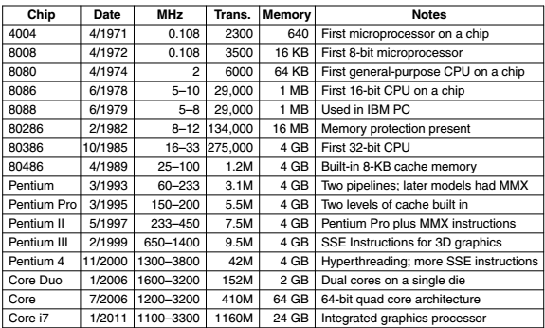
The Intel CPU Family

Slide 13
The ARM Architecture
In the early 80s, the U.K.-based company Acorn Computer, flush with the success of their 8-bit BBC Micro personal computer, began working on a second machine with the hope of competing with the recently released IBM PC
The BBC Micro was based on their own 8-bit 6502 processor
They called their design the Acorn RISC Machine
The design was completed in 1985
It included 32-bit instructions and data, and a 26-bit address space, and it was manufactured by VLSI Technology
The first ARM architecture (called the ARM2) appeared in the Acorn Archimedes personal computer and became very popular

Slide 14
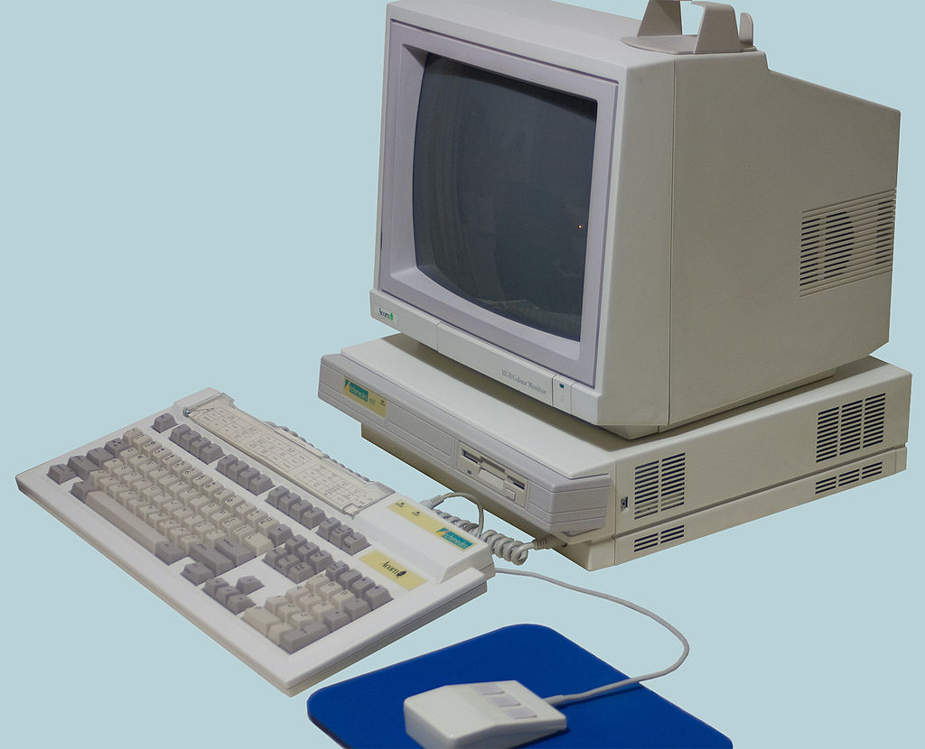
The ARM Architecture

Slide 15
ARM Usage
The CPU used in the Samsung Galaxy Tab Android-based tablet computer is an ARM-based processor
The Galaxy Tab contains the includes two ARM Cortex-A9 processors and an Nvidia GeForce graphics processing unit
The ARM architecture has found great success in the low-power, mobile and embedded markets
In January 2011, ARM announced that it had sold 15 billion ARM processors since beginning

Slide 16
Performance Improvement Reasons
Microprocessor speed has been improving by about 35% each year since the 1970s
Assembly language programming became rarer (as languages such as C emerged), so object code compatibility did not remain a problem
Standard, vendor-independent operating systems such as UNIX and Linux lowered the cost and risk of bringing out a new architecture

Slide 17
Computer Level/Layer Hierarchy

Slide 18
Computer Level Hierarchy
Suppose we want to design a computer that can accept two numbers and display the result of their multiplication
The problem needs to be broken down into smaller steps:
Accept the two numbers from the user
Store the numbers somewhere
Multiply them and store the result somewhere
Display the result back to the user
Hence, it helps us think about a computer as made up of various levels or layers of hierarchy – See next slide

Slide 19
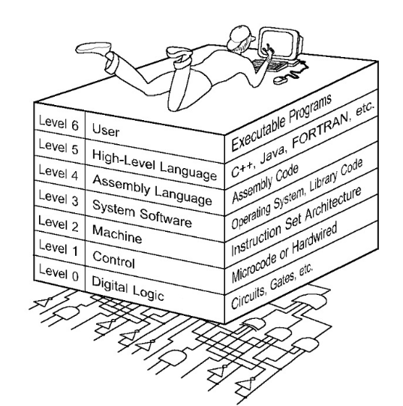
Computer Level Hierarchy

Slide 20
Computer Hierarchy Levels …
Level 6: The User Level
Program execution and user interface level
Generally most familiar to us
Level 5: High-level Language Level
Programming languages such as Java, C, Python
Level 4: Assembly-level Language Level
Acts on the assembly language produced from level 5, as well as instructions programmed directly at this level

Slide 21
Computer Hierarchy Levels …
Level 3: System Software Level
Controls executing processes on the system
Protects system resources
Assembly language instructions often pass through level 3 without modification
Level 2: Machine Level
Also called as the Instruction Set Architecture (ISA) level
Consists of instructions that are specific to the given machine
Programs written in machine language need no compilers, interpreters, assemblers
Level 1: Control Level
A control unit decodes and executes instructions and moves data through the system
Control units can be microprogrammed (software) or hardwired (hardware)

Slide 22
Computer Hierarchy Levels …
Level 0: Digital Logic Level
Consists of digital circuits (i.e. electronic chips)
Digital circuits are made up of gates and wires
Implement the actual instructions
On ENIAC, one of the very first computers, all the programming needed to be done at the digital logic level
Programs = Moving plugs and wires
New problem = New hardware configuration

Slide 23
Today’s Digital Computer
A digital computer is a machine that can do work for people by carrying out instructions given to it
A sequence of instructions describing how to perform a certain task is called a program
The electronic circuits of each computer can recognize and directly execute a limited set of simple instructions into which all its programs must be converted before they can be executed
These basic instructions are rarely much more complicated than
Add two numbers
Check a number to see if it is zero
Copy a piece of data from one part of the computer’s memory to another

Slide 24
Machine language
Together, a computer’s basic instructions form a language in which people can communicate with the computer
Such a language is called a machine language
The people designing a new computer must decide what instructions to include in its machine language
Usually, they try to make the primitive instructions as simple as possible to reduce the complexity and cost of the electronics needed
Because most machine languages are so simple, it is difficult for people to use them

Slide 25
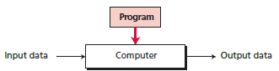
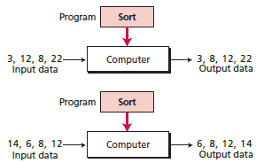
A programmable computer

Slide 26
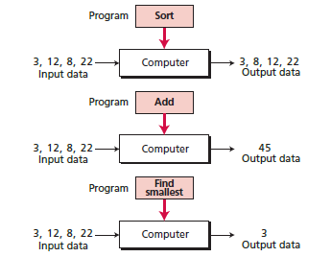
Same data, different programs

Slide 27
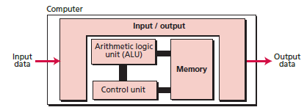
The von Neumann model

Slide 28
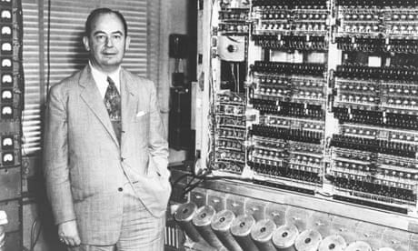
Stored Program Concept
John von Neumann created this idea
Main characteristics
A Central Processing Unit (CPU)
A main memory system
An Input/Output (I/O) system
Capable of executing instructions sequentially
A single data path exists between the CPU and the main memory
Called as the von Neumann bottleneck

Slide 29
von Neumann versus Harvard Architecture
The von Neumann architecture is a theoretical computer design based on the concept of stored-program where programs and data are stored in the same memory.
Harvard architecture refers to a memory structure in which the processor is connected to two independent memory banks via two independent sets of buses.
In the original Harvard architecture, one memory bank holds program instructions and the other holds data.
Commonly, this concept is extended slightly to allow one bank to hold program instructions and data, while the other bank holds data only.
See next slide

Slide 30
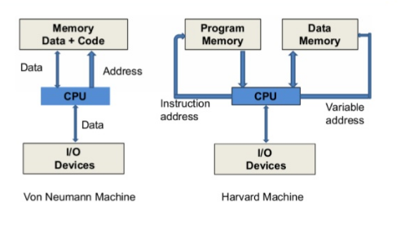
von Neumann versus Harvard Architecture

Slide 31
The ‘Bus’ Concept

Slide 32
Computer Bus
The computer bus is a communication link (set of wires) used inside a computer to send data, addresses, control signals, and power to various hardware components
Buses connect various hardware components to each other
Bus types
Address bus: Connects CPU to RAM, used for specifying memory addresses for reading or writing of data
Data bus: Connects CPU to RAM, specifies data to be written or contains data that was read
Control bus: Connects CPU to RAM for passing control signals
Address bus + Data bus + Control bus = System bus

Slide 33
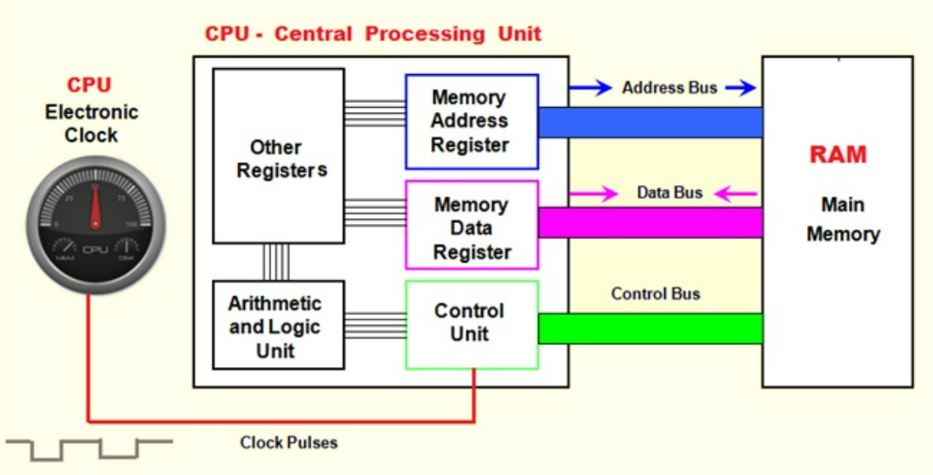
Buses inside a Computer

Slide 34
Bus Width
Specifies the number of bits in the bus
Determines how much of information it can carry
More the number of bits, larger is the width of the bus, and the better it is
Generally measured as 8-bit, 16-bit, 32-bit, 64-bit, etc
Early computers had 8-bit buses, now 32-bit and 64-bit are common
For example, a 16-bit data bus means 16 bits of data can flow between the CPU and the main memory in one read/write operation (See next slide)

Slide 35
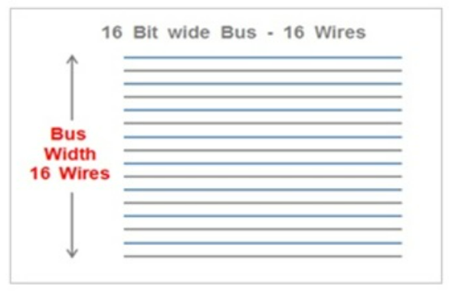
A 16-bit Data Bus

Slide 36
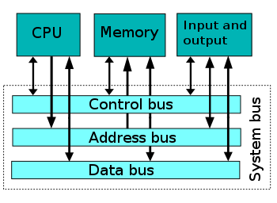
System Bus
A system bus is a single computer bus that connects the major components of a computer system, combining the functions of a data bus to carry information, an address bus to determine where it should be sent or read from, and a control bus to determine its operation
The technique was developed to reduce costs and improve modularity, and although popular in the 1970s and 1980s, more modern computers use a variety of separate buses adapted to more specific needs

Slide 37
System Bus – The Early Situation
On the original IBM PC, most applications were text based
Gradually, with the introduction of Windows, graphical user interfaces came into use
Let us make a simple calculation
Consider a 1024 × 768 color video with 3 bytes/pixel
One frame contains 2.25 MB of data
For smooth motion, at least 30 screens/sec are needed, for a data rate of 67.5 MB/sec
The early bus (the ISA bus), ran at a maximum rate of 8.33 MHz and could transfer 2 bytes per cycle, for a maximum bandwidth of 16.7 MB/sec

Slide 38
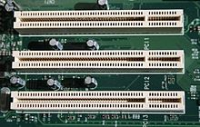
System Bus – The PCI Bus
In 1990, Intel saw this coming and designed a new bus with a far higher bandwidth than the EISA bus
It was called the PCI bus (Peripheral Component Interconnect bus)
The original PCI bus transferred 32 bits per cycle and ran at 33 MHz (30-nsec cycle time) for a total bandwidth of 133 MB/sec
The demand for PCI expansion cards has steadily declined
More standard ports such as Ethernet and SATA are now integrated into the motherboard
Many devices that once required an expansion card can now be connected over a fast USB 2.0 or 3.0 link
Also, video cards now require far more bandwidth than PCI can supply
PCI Bus slots

Slide 39
PCI Bus – Problems
Increasingly, many I/O devices are too fast for the PCI bus
Every time an I/O device gets too fast for the PCI bus (like the graphics card, hard disk, network, etc.), Intel adds a new special port to the bridge chip to allow that device to bypass the PCI bus
Clearly, this is not a long term solution either
Another problem with the PCI bus is that the cards are quite large
Standard PCI cards are generally 17.5 cm by 10.7 cm and low-profile cards are 12.0 cm by 3.6 cm
Neither of these fit well in laptop computers and certainly not in mobile devices

Slide 40
PCI Express
Several solutions to the PCI problems have been proposed, but the one that won a place in all modern PCs today is called PCI Express
It has little to do with the PCI bus and in fact is not a bus at all, but the marketing folks did not like letting go of the well-known PCI name
PCs containing it are now the standard

Slide 41
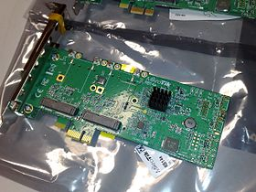
PCI Express Card

Slide 42
PCI Express (Diagram on the next slide)
The heart of the PCI Express solution (often abbreviated PCIe) is to get rid of the parallel bus with its many masters and slaves and go to a design based on highspeed point-to-point serial connections
This solution represents a radical break with the ISA/EISA/PCI bus tradition, borrowing many ideas from the world of local area networking, especially switched Ethernet
The basic idea is: a PC is a collection of CPU, memory, and I/O controller chips that need to be interconnected
What PCI Express does is provide a general-purpose switch for connecting chips using serial links

Slide 43
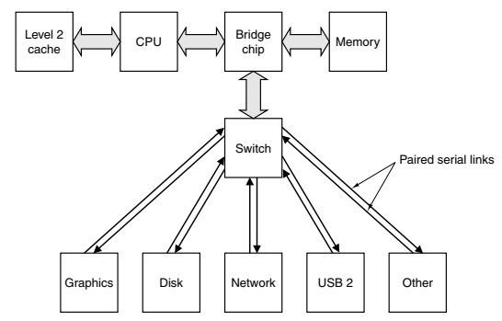
PCI Express

Slide 44
PCI Express – Architecture
In PCI Express, the CPU, memory, and cache are connected to the bridge chip in the traditional way
A switch is connected to the bridge (possibly part of the bridge chip itself or integrated directly into the processor)
Each I/O chip has a dedicated point-to-point connection to the switch
Each connection consists of a pair of unidirectional channels, one to the switch and one from it
Each channel is made up of two wires, one for the signal and one for ground, to provide high noise immunity during high-speed transmission
This architecture has replaced the old one with a much more uniform model, in which all devices are treated equally

Slide 45
PCI Express versus Older Buses
PCI Express has a centralized switch versus a multidrop bus in the earlier buses
PCI Express uses narrow serial point-to-point connections versus a wide parallel bus, which was used earlier
The conceptual model behind the PCI bus is that of a bus master issuing a command to a slave to read a word or a block of words
The PCI Express model is that of a device sending a data packet to another device
The concept of a packet, which consists of a header and a payload, is taken from the networking world
In effect, a PC with PCI Express is a miniature packet-switching network

Slide 46
CPU/Processor Speed

Slide 47
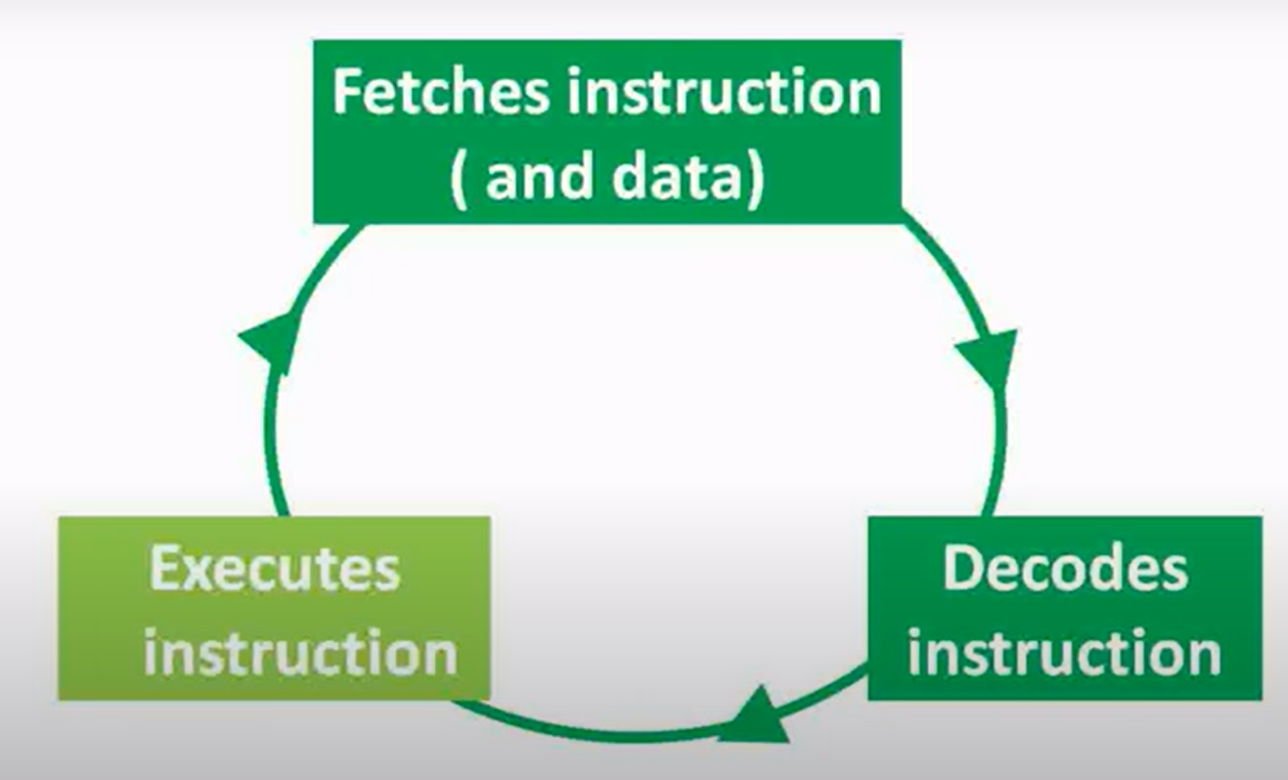
CPU Actions: Fetch-Decode-Execute

Slide 48
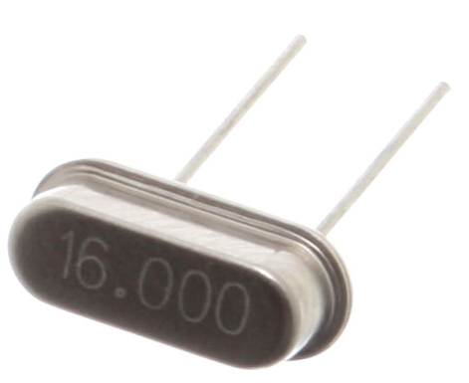
Clock Speed
Each CPU has a built-in quartz clock/oscillator that continuously generates a pulse at a very short frequency
At every pulse, the CPU carries a part of an instruction
Usually, 1 instruction = multiple CPU clock cycles
(See next slide)
The speed of the oscillations is measured in Hz
More the oscillations, higher is Hertz per second
Higher the Hertz per second, faster will be the computer
Reason: More the number of instructions it can carry out per second

Slide 49
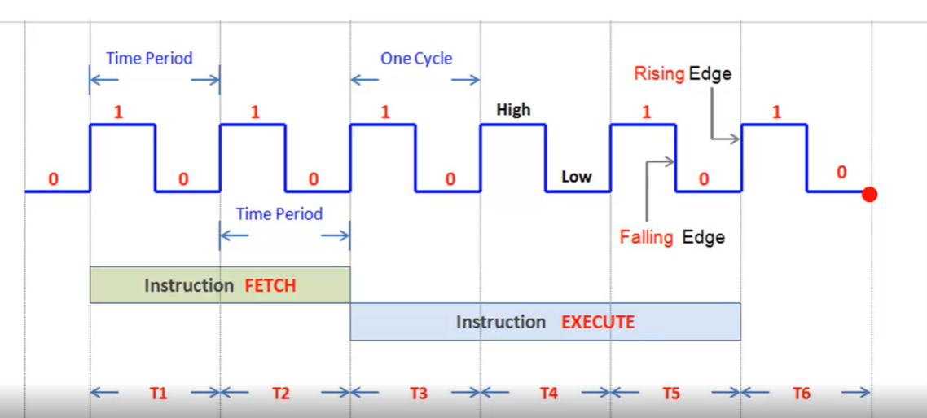
CPU Cycles and Instructions

Slide 50
CPU Speed – More Details
One of the first CPU chips - the Intel 4004, had 4-bit data bus and a clock speed of 108 KHz
So, 108 thousand clock cycles per second
Intel Core i3 has 4 billion cycles per second, per core!

Slide 51
Fetch-Decode-Execute Cycle

Slide 52
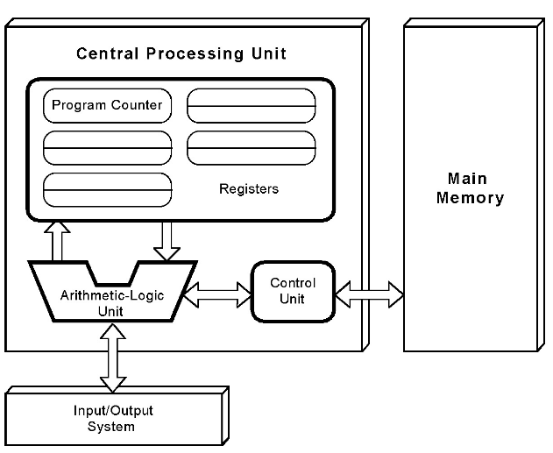
von Neumann System: Fetch-Decode-Execute

Slide 53
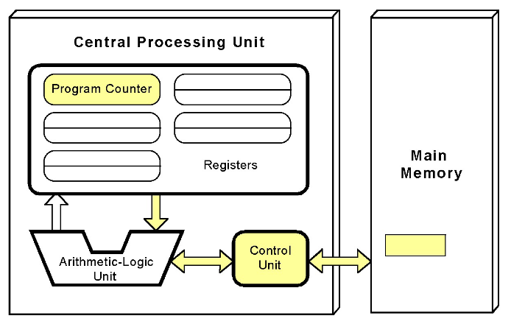
The Control Unit fetches the next instruction from the memory using Program Counter

Slide 54
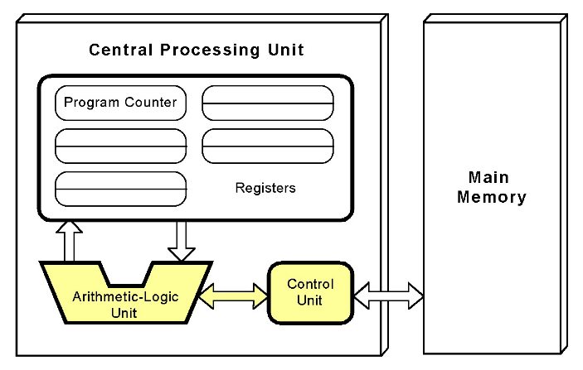
Instruction is decoded in a language that the ALU understands

Slide 55
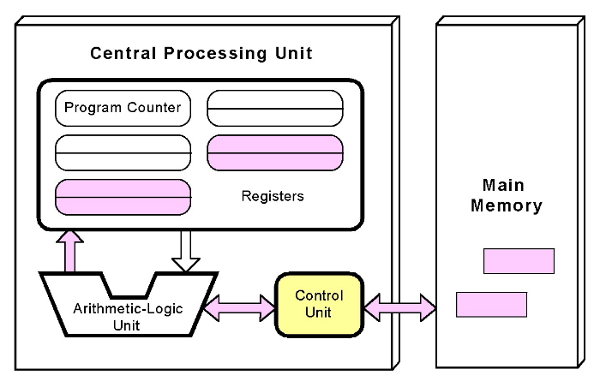
Required operands are fetched from the memory and placed into registers

Slide 56
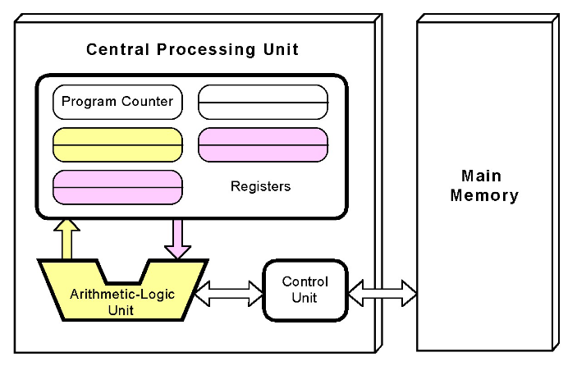
ALU executes the instruction and places the result into registers

Slide 57
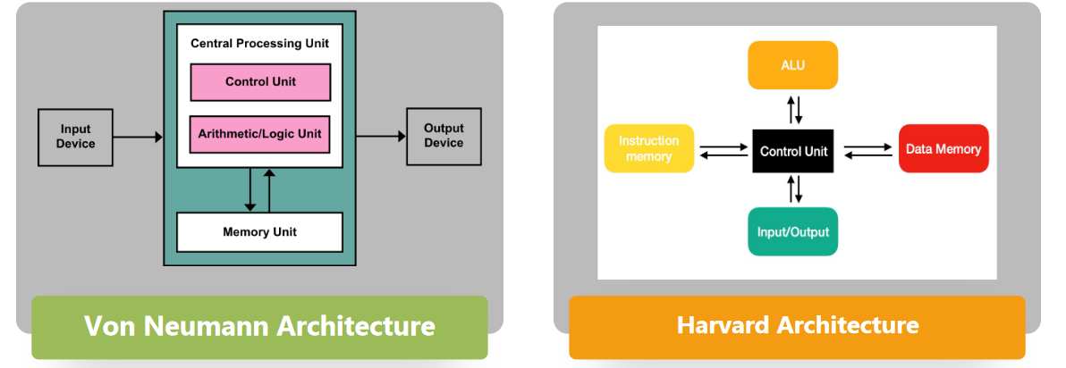
Activity: Compare von Neumann Architecture and Harvard Architecture
Separate memory for instructions and data

Slide 58
Fetch-Decode-Execute Cycle
Program instructions are stored in the main memory
The computer runs the program sequentially, one machine instruction after the other
Each instruction is fetched, decoded, and executed during one cycle
One cycle consists of the following:
The control unit fetches the next instruction to be executed from the main memory, using the Program Counter to determine where the instruction is located
The instruction is decoded into a language that the ALU can understand
Any operands needed to execute the instruction are fetched from the main memory and placed inside the registers in the CPU
The ALU executes the instruction and places the results into the registers

Slide 59
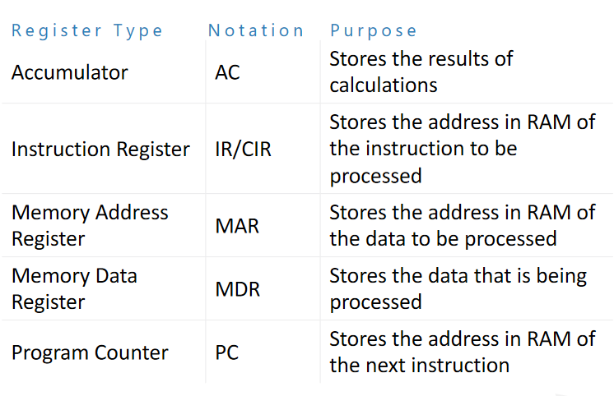
Special Purpose Registers

Slide 60
The Little Man Computer

Slide 61
Understanding Fetch-Decode-Execute Cycle
Visit https://peterhigginson.co.uk/lmc/
(Another version is: https://www.101computing.net/LMC/)
This tool will help us understand how the fetch-decode-execute cycle works

Slide 62
Program to Accept User Input
INP
STA 20
OUT
HLT
This program will accept an input from the user and will display it back to the user

Slide 63
Same Program, this time User Input Stored in a Variable without specifying a Memory Location
INP
STA A
OUT
HLT
A DAT

Slide 64
Store one input in a variable, another at an address
INP
STA A
INP
STA 20
LDA A
OUT
LDA 20
OUT
HLT
A DAT

Slide 65
Sample Program
Add three numbers stored in memory cells 60, 61, and 62 and store the result in memory cell 65
Use these values: Memory cell 60: 005, Memory cell 61: 006, Memory cell 62: 002

Slide 66
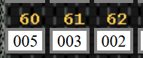
Setting values
Manually enter these values in the specified memory locations
Now we need to load these numbers from RAM to CPU
To see the instructions that we need to use, click on the Help Table button
We can see that we need to use the LOAD (LDA) instruction with op code 005 to load the accumulator with the contents of the given memory address

Slide 67
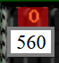
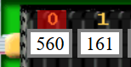
Loading the memory contents into CPU (Accumulator)
LOAD instruction is 5xx, where
5 is the instruction itself (LOAD)
The remaining two places identify the memory address from where we want to load the contents (i.e. the address of the operand)
Therefore, for the first instruction, this will be 560
Go to memory location 0 and type 560 there
Then we want to add the contents of memory location 61 to this value in the accumulator – we need the ADD instruction
ADD instruction is 1xx, where
1 is the instruction itself (ADD)
The remaining two places identify the memory address, which is 61
Therefore, the second instruction will be 161, which we will place in memory location 1

Slide 68
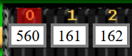
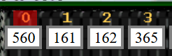
Completing the Addition
The third instruction is to add the value at memory location 62 to the accumulator, so the instruction will be 162,as before
Store this instruction in memory location 2
Finally, store the results back in memory location 65
The instruction is STORE (STA or STO) with op code 3
As before, our instruction will now become 365
Store this instruction in memory location 3

Slide 69
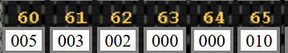
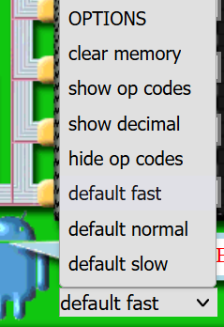
Executing the Program
Click on Run
You can see step by step execution, or just the result etc by changing the options

Slide 70
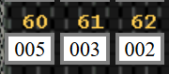
Writing Assembly Language Code
Instead of directly manipulating the memory locations, we can write assembly language code for the same problem:
First store the three numbers in memory manually, as before (if the memory locations have become read-only, try clicking on the Input area)
In the Assembly language code area, enter this code, then Click on Assemble into RAM and Run:
LDA 60
ADD 61
ADD 62
STA 65
HLT

Slide 71
Another Addition: Using Variables
INP
STA A
INP
STA B
LDA A
ADD B
OUT
HLT
A DAT
B DAT

Slide 72
Same Program without User Input
LDA A
LDA B
ADD A
OUT
HLT
A DAT 4
B DAT 5

Slide 73
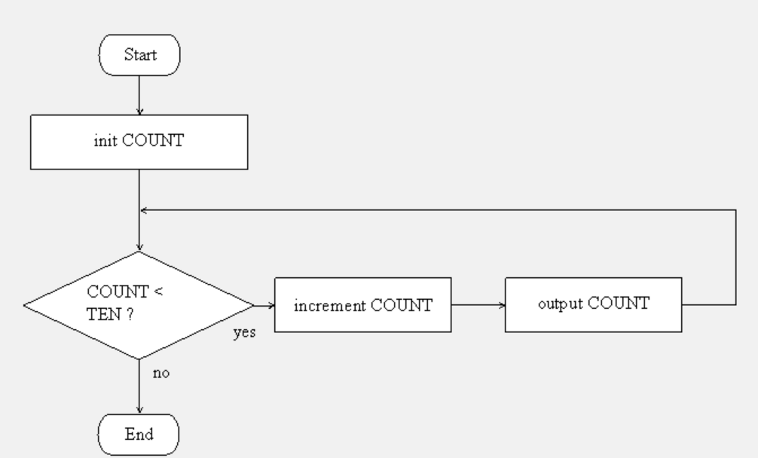
Write a program to Run a Loop 10 Times

Slide 74
Code
Code explanation
After the program is loaded, memory locations 0 to 9 will get filled with instructions of the code. HLT will be at memory location 10.
DAT instructions will reserve memory location 11 to store a value 001 and call it as ONE, location 12 to store a value 010 and call it as TEN, and location 13 to store COUNT with no initial value.
LOOPTOP is the first instruction in the loop. A BRANCH instruction will cause jump back to the start of the loop. In the loop, COUNT is loaded into accumulator, one is added to it, new value is displayed, and the new COUNT value is stored back in memory.
The SUB instruction decrements the value of variable TEN (which is always 10 in our program) from the accumulator. The BRP condition checks if accumulator is 0, and if yes, branches to ENDLOOP instruction.
LDA ONE
STA COUNT
OUT
LOOPTOP LDA COUNT
ADD ONE
OUT
STA COUNT
SUB TEN
BRP ENDLOOP
BRA LOOPTOP
ENDLOOP HLT
ONE DAT 001
TEN DAT 010
COUNT DAT

Slide 75
Using the Little Man Computer on our own PC
https://sourceforge.net/projects/lmce/

Slide 76
Assembly Language: Key Technical Concepts

Slide 77
Assembly Language
Uses symbolic codes rather than 0s and 1s
The symbolic codes are called mnemonics
The computer hardware cannot understand the mnemonics
Hence, an assembler program needs to first translate the mnemonics into the corresponding machine language code
Add A
Assembler program
160

Slide 78
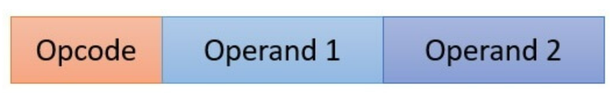
Op Code and Operands
A mnemonic is made up of two parts:
Op code: Specifies the operation/instruction to be performed
Operand: The data/value or the memory location on which the op code is going to work
Example: Add A
Add is the op code
A is the operand

Slide 79
Addressing Modes
Most assembly language instructions require operands to be processed.
An operand address provides the location, where the data to be processed is stored.
Some instructions do not require an operand, whereas some other instructions may require one, two, or three operands.
When an instruction requires two operands, the first operand is generally the destination, which contains data in a register or memory location and the second operand is the source.
Source contains either the data to be delivered (immediate addressing) or the address (in register or memory) of the data.
Generally, the source data remains unaltered after the operation.
There are three addressing modes: register, immediate, and memory

Slide 80
Addressing Modes
Most assembly language instructions require operands to be processed.
An operand address provides the location, where the data to be processed is stored.
Some instructions do not require an operand, whereas some other instructions may require one, two, or three operands.
When an instruction requires two operands, the first operand is generally the destination, which contains data in a register or memory location and the second operand is the source.
Source contains either the data to be delivered (immediate addressing) or the address (in register or memory) of the data.
Generally, the source data remains unaltered after the operation.
There are three addressing modes: register, immediate, and direct (memory)

Slide 81
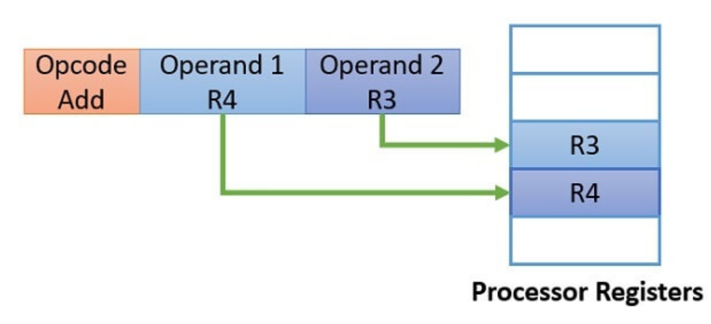
Register Addressing Mode
Here, the operands for the instruction are in the CPU registers
Hence, to execute the instruction, the CPU just needs to access the registers for accessing data, and nothing else
Example: Add R4, R3
Fastest
But we have limited registers

Slide 82
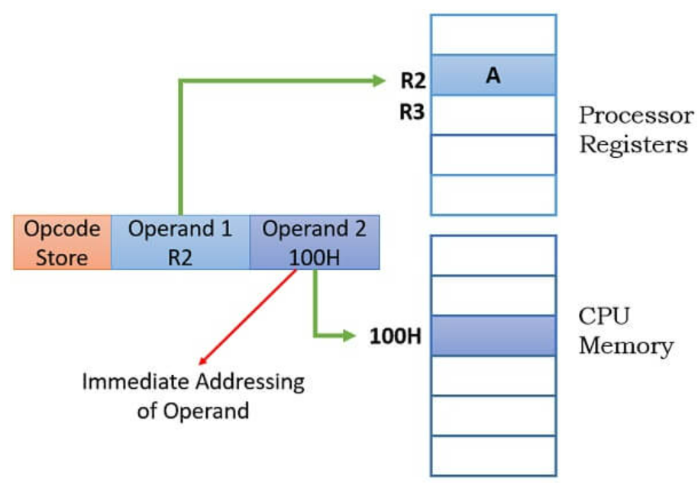
Immediate Addressing
The value of the operand is explicitly mentioned in the instruction.
Example: Add R2, #5 … Hash indicates that this is the direct value and not an address
No memory access needed
Value size can be limited

Slide 83
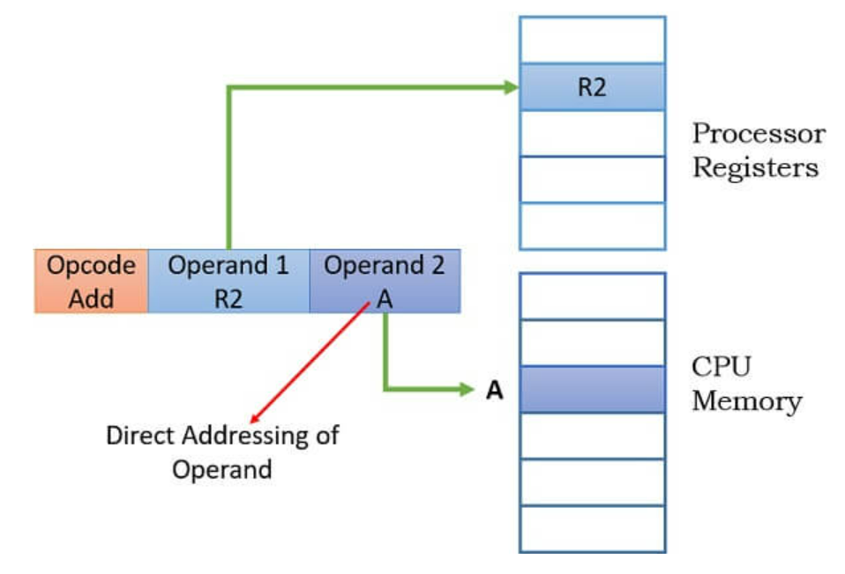
Direct/Memory (Absolute) Addressing Mode
The instruction contains the address of the location in memory where the value of the operand is stored.
Example: Add R2, A
Simplest
Limited by register and memory size

Slide 84
Number Systems and Data Representation

Slide 85
Number Systems
We work with decimal numbers (0-9)
Modern computers do not work with decimal numbers – they use binary numbers (0-1)
Why? Because electronic devices are most reliable when designed for two-state (binary) operations

Slide 86
Decimal Odometer
When a car is just manufactured, it has run 0 kilometers
Hence its odometer shows 00000
After running for 1 kilometer, the odometer shows 00001
This goes on up to 00009
After 10 kilometers are complete, the units wheel turns back from 9 to 0 and a tab on this wheel forces the tens wheel to advance by 1, so we now have 00010

Slide 87
Reset and Carry
What has happened?
The units wheel has reset to 0 and has sent a carry to the tens wheel
This action can be called as reset and carry
The other wheels also reset and carry
After 999 kilometers, the odometer shows 00999
After 1 more kilometer, the unit wheel resets and carries, the tens wheel resets and carries, the hundreds wheel resets and carries, and the thousands wheel advances by 1
So, after 999 kilometers, the odometer shows 01000

Slide 88
Digits
The numbers on each odometer wheel are called as digits
The decimal number system uses ten digits, 0 through 9
In a decimal odometer, each time the unit wheel runs out of digits, it resets to 0 and sends a carry to the tens wheel
When the tens wheel runs out of digits, it resets to 0 and sends a carry to the hundreds wheel
And so on …

Slide 89
Binary Odometer
Binary means two
The binary number system uses only two digits: 0 and 1
The other digits 2-9 are not used
So, a binary odometer will only have two digits: 0 and 1
When each wheel turns, it displays 0 and then 1
Then it is back to 0 and again back to 1
And so on …

Slide 90
A Car with a Binary Odometer
Starting position
0000 Zero
After 1 kilometer
0001 One
After 2 kilometers, reset and carry of units wheel
0010 Two
After 3 kilometers
0011 Three
After 4 kilometers, reset and carry of units wheel and the second wheel; the third wheel advances by 1
0100 Four

Slide 91
A Car with a Binary Odometer
After 4 kilometers, reset and carry of units wheel and the second wheel; the third wheel advances by 1
0100 Four
Next few values
0101 Five
0110 Six
0111 Seven
After 8 kilometers, reset and carry of units wheel, the second wheel, and the third wheel; the fourth wheel advances by 1
1000 Eight

Slide 92
A Car with a Binary Odometer
After 8 kilometers, reset and carry of units wheel, the second wheel, and the third wheel; the fourth wheel advances by 1
1000 Eight
After 9 kilometers, we have
1001 Nine
After 10 kilometers, we have
1010 Ten
And so on ..

Slide 93
Binary Numbers
A binary odometer displays binary numbers, which are strings of 0s and 1s
Binary 0000 stands for decimal 0
Binary 0001 stands for decimal 1
Binary 0010 stands for decimal 2
Binary 0011 stands for decimal 3
For large decimal numbers, binary numbers are long
For example, decimal 42 in binary is 101010

Slide 94
Exercise
A binary odometer has four wheels. What are the successive binary numbers?

Slide 95
Bit
Binary Digit = Bit
A binary number 1010 has 4 bits
A binary number 100100 has 6 bits
One bit is stored in one transistor

Slide 96
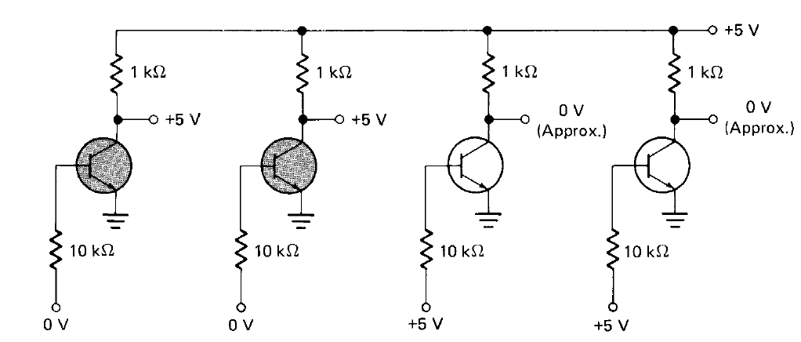
A 4-bit Transistor Register
0 volts are supplied to the first two transistors and +5 volts are supplied to the remaining two, so the register currently has a value 0011

Slide 97
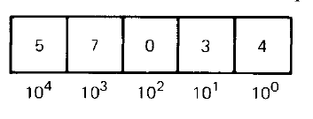
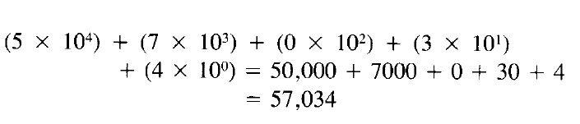
Decimal Weights
Each digit in a decimal number has a positional weight
Here, the weights are units, tens, hundreds, thousands, and so on
Sum of all the digits multiplied by their respective weights gives the total value of the number
Example: 57034 in decimal

Slide 98
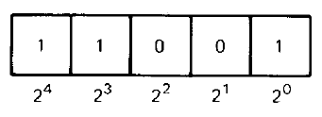
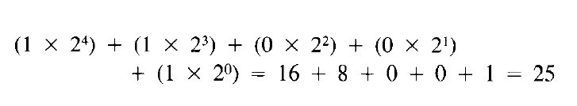
Binary Weights
Even in binary number, each bit has a positional weight
Since only two digits or bits are used, the weights are powers of 2, instead of 10
Example: 11001 in binary

Slide 99
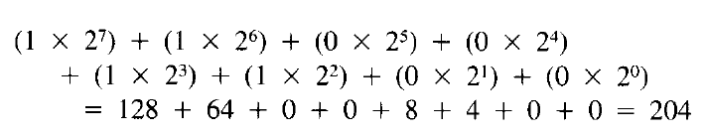
Binary to Decimal Conversion
This tells us how to convert a binary number into decimal
As another example, consider a binary number 11001100
So, binary 11001100 in decimal is 204

Slide 100
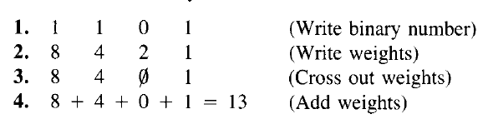
Binary to Decimal Conversion – Faster/8421 Method
Write the binary number
Write the weights 1, 2, 4, 8, 16, … under the bits from right to left
Cross out weights under a 0
Add the remaining weights
Example: Convert binary 1101 into decimal

Slide 101
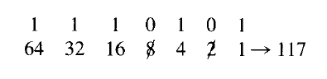
Binary to Decimal – Even Shorter Method
Convert binary 1110101 in decimal

Slide 102
Base or Radix
Base or radix of a number system is equal to the number of digits it has
Decimal number system’s base is 10 (Digits 0-9 are used)
Binary number system’s base is 2 (Digits 0-1 are used)
A subscript denotes the base
Examples:
100₁₀ is decimal 100 (hundred)
100₂ is binary 100 (one zero zero)
So, we can say that 1101₂ = 13₁₀

Slide 103

Measuring bits – the K Notation

Slide 104

Decimal to Binary Conversion
Write the decimal number
Divide it by 2 and write the quotient and remainder
Keep doing it till we get a quotient of 0
Write the remainder in the reverse order to get the binary number

Slide 105

Decimal to Binary – Example
Convert decimal 125 into binary

Slide 106
Hexadecimal Numbers
Hexadecimal (hex) numbers are extensively used in microprocessor work
They are much shorter than binary numbers
Hexadecimal means 16, so the hexadecimal number system has a base of 16
The 16 digits in hexadecimal number system are numbers 0 to 9 and letters A to F
In a hexadecimal odometer, each wheel will use 16 symbols to represent numbers: it will display 0 to 9 but then it will not get reset and use symbols A to F; after F it will be reset

Slide 107
Hexadecimal Odometer
0000 Zero
0001 One
0002 Two
0003 Three
…
0009 Nine
000A Ten
000B Eleven
000C Twelve
000D Thirteen
000E Fourteen
000F Fifteen

Slide 108
Hexadecimal Odometer
000F Fifteen
0010 Sixteen
0011 Seventeen
…
0019 Twenty five
001A Twenty six
001B Twenty seven
…
0020 Thirty two

Slide 109

Equivalence

Slide 110


Hexadecimal to Binary Conversion
If you remember the previous table, we can simply convert each hexadecimal digit to its 4-bit binary equivalent
Examples

Slide 111


Binary to Hexadecimal Conversion
Now do the opposite!
Examples

Slide 112

Exercise
Find hexadecimal equivalent of
Find hexadecimal equivalents of

Slide 113
Exercise
Find binary equivalents of

Slide 114

Hexadecimal to Decimal Conversion
Convert F8E6 in hexadecimal to decimal

Slide 115

Decimal to Hexadecimal Conversion
Convert 3479 in decimal to hexadecimal

Slide 116

BCD Numbers
A nibble is string of four bits
Binary-coded-Decimal (BCD) numbers express each decimal digit as a nibble
Example: Decimal number 2945 in BCD is 0010 1001 0100 0101

Slide 117

BCD to Decimal

Slide 118
The ASCII Code
Computers deal with numbers, alphabets, and other symbols
American Standard Code for Information Interchange (ASCII) is a standardized code is a 7-bit code used for this codification
Assigns a fixed code to each symbol

Slide 119

The ASCII Table
Example:
Alphabet A: 100 0001
Number 5: 011 0101

Slide 120
Unicode
Unicode is a universal character encoding standard
This standard includes roughly 100000 characters to represent characters of different languages
While ASCII uses only 1 byte the Unicode uses 4 bytes to represent characters
Hence, it provides a very wide variety of encoding

Slide 121
Logic Gates

Slide 122
Boolean Algebra
In 1854, George Boole invented symbolic logic, now called as Boolean Algebra to complete the missing link between mathematics and logic
This is the basis for a logic gate, an electronic circuit that has one or more input signals but only one output signal
They are the fundamental components of a digital computer

Slide 123


Inverter
Has only one input and only one output
The output is the inverse/opposite of the input, hence called as inverter
Creates a NOT gate (because the output is not the same as the input)
Sometimes, the output is called as the complement of the input
Symbol and Truth table

Slide 124


Boolean Algebra – Inverter (NOT Gate)
In Boolean algebra, a variable can be either a 0 or a 1.
Consider an inverter (NOT gate)
Y = NOT A, written as
If A = 0, Y = NOT 0 = 1
If A = 1, Y = NOT 1 = 0

Slide 125

Boolean Algebra – Inverter (NOT Gate)
Basic circuit – Use on the next slide

Slide 126


Boolean Algebra – Inverter (NOT Gate)
When input is 1, switch is closed, output is 0
When input is 0, output is 1

Slide 127


OR Gate
Has two or more inputs but only one output
If any input is high, the output is high

Slide 128

Decimal to Binary Encoder using OR Gates

Slide 129


Boolean Algebra – OR Gate Operations
Consider an OR gate
We write Y = A OR B
If A = 0, B = 0, Y = 0 OR 0 = 0
If A = 0, B = 1, Y = 0 OR 1 = 1
If A = 1, B = 0, Y = 1 OR 0 = 1
If A = 1, B = 1, Y = 1 OR 1 = 1
In Boolean algebra, we use the + sign to indicate an OR operation
So, Y = A OR B, i.e. Y = A + B (read as Y equals A OR B)

Slide 130




OR Gate Operations

Slide 131


AND Gates
Has two or more inputs, but only one output
All inputs must be high to get a high output

Slide 132


Boolean Algebra – AND Gate Operations
Consider an AND gate
We write Y = A AND B
If A = 0, B = 0, Y = 0 AND 0 = 0
If A = 0, B = 1, Y = 0 AND 1 = 0
If A = 1, B = 0, Y = 1 AND 0 = 0
If A = 1, B = 1, Y = 1 AND 1 = 1
In Boolean algebra, we use the multiplication (x) sign to indicate an AND operation
So, Y = A AND B, i.e. Y = A x B (read as Y equals A AND B)

Slide 133




AND Gate Operation – Four Cases

Slide 134


NOR Gate
It is the opposite of OR gate
All the inputs to a NOR gate must be low to get a high output

Slide 135


NAND Gate
It is the opposite of AND gate
All the inputs to a NOR gate must be high to get a low output

Slide 136


XOR Gate
Only if we have an odd number of high inputs, the output is high

Slide 137
Binary Addition
Rules of binary addition
0 + 0 =0
0 + 1 = 1
1 + 0 = 1
1 + 1 = 10
1 + 1 + 1 = 11

Slide 138





Binary Addition Example
Add two binary numbers: 11100 and 11010
Here, 1 + 1 + 1 (carry) produces 11, recorded as 1 with a carry of 1 to the next higher column

Slide 139
Binary Subtraction
Rules of binary subtraction
0 – 0 = 0
1 – 0 = 1
1 – 1 = 0
10 – 1 = 1

Slide 140


Binary Subtraction Example
Computers use different techniques for binary subtraction, as we will discuss soon

Slide 141



Half Adder
XOR
Half adder is a logic circuit that adds 2 bits
It produces two outputs: sum and carry
Sum = 1 when A and B are different
Carry = 1 when A and B are 1

Slide 142



Full Adder
XOR is true when we have ODD number of 1s
Full adder is a logic circuit that can add 3 bits

Slide 143
Signed Binary Numbers
Negative decimal numbers are -1, -2, -3, etc
For binary numbers, positive sign is 0 and negative sign is 1, so:
In binary 0001 means +1 and 1001 means -1
In binary 0010 means +2 and 1010 means -2, etc
Such numbers are called signed binary numbers or sign-magnitude numbers
Example: Express the following as 16-bit signed binary numbers:
+7, -7, +25, -25
Solution: Next slide

Slide 144

Sign-Magnitude Numbers Example

Slide 145

2’s Complement
Sign-magnitude numbers are easy to understand, but they need too much hardware for addition and subtraction
Hence, complements are used for binary arithmetic
Consider a number A = 0111
Its complement is 1000, also called as the 1’s complement of a number
The 2’s complement of a number is obtained by adding 1 to the 1’s complement of a number:

Slide 146
Calculate 2’s Complement
A = 0111
Ā = 1000
A’ = 1000 + 1 = 1001

Slide 147
2’s Complement - Practical Usage
If we take the 2’s complement of a number twice, we get the original number back
Example:
A = 0111
Ā = 1000
A’ = 1000 + 1 = 1001
So we now start with A = 1001 now
Ā = 0110
A’ = 0110 + 1 = 0111, which was our original number
So, we can say that A’’ = A

Slide 148

Sample Binary Odometer with Negative and Positive Numbers
Double complement logic
Consider a positive number 0010 in binary, i.e. 2 in decimal
Its 1’s complement is 1101
So, its 2’s complement is 1110
1110 in decimal is -2
So, 0010 (i.e. +2) and 1110 (i.e. +2) are 2’s complements of each other
1101
1110
1111
0000
0001
0010
0011
Negative numbers
Positive numbers
Important conclusion: Taking a 2’s complement of a number is the same as changing its sign (i.e. positive to negative or vice versa)

Slide 149
2’s Complement and Binary Arithmetic
With sign-magnitude numbers, we require separate digital circuits for binary addition and subtraction
With 2’s complement, we can use a simple digital circuit to perform both addition and subtraction – how?
Consider two binary calculations: 0101 + 0010 and 0101 – 0010
Addition is simple
To perform subtraction, we take 2’s complement of the second number: 0010->1’s complement: 1101-> 2’s complement: 1110
We then add (and not subtract) the second number to the first number
Summary: We use add circuit for subtraction also – See next slide

Slide 150
2’s Complement and Binary Arithmetic
Addition
0101 (+5)
+ 0010 (+2)
-------------
0111 (+7)
Subtraction using 2’s complement
0101 (+5)
+ 1110 (+2)
-------------
0011 (+3)
Normal Subtraction would be …
0101 (+5)
- 0010 (+2)
-------------
0011 (+3)
To subtract 0010 from 0101, we first take 1’s complement of 0010, which is 1101. We then take the 2’s complement, which is 1110. We then add this 2’s complement to the first number, although this is a subtraction operation.

Slide 151

Storage of Data in Memory

Slide 152

How are Characters Stored in Memory?

Slide 153

Character Storage Example

Slide 154
Integer Storage Example
Integers are whole numbers which will be stored in computer using 4 bytes (32 bit) of memory
Example: For integer 65, binary representation is 1000001
The MSB (most significant bit) bit is used to indicate whether the number is positive or negative
For positive numbers MSB will be 0
For negative numbers MSB will be 1
In our case, 65 is positive so MSB will be 0
This binary equivalent of 65 will be stored in 32-bit memory

Slide 155

Integer Storage Example

Slide 156
Negative Integers Storage in Memory
Computer uses special mechanism to store negative numbers which is 2’s complement format
Consider a decimal number 10 - its binary value will be 1010
Represented in 32 bits, it will be 00000000000000000000000000001010
Its 1's complement will be 11111111111111111111111111110101
2's complement will be 11111111111111111111111111110110
This will be stored in the memory

Slide 157

Negative Integers Storage in Memory

Slide 158

Floating Point Numbers Storage in Memory
First, we need to convert a floating point number into binary
Consider a number 4.25 in decimal
Converting the integer part: Use division
So, 4₁₀ = 100₂
To convert the fractional part to binary, multiply fractional part with 2 and take the one bit which appears before the decimal point
Follow the same procedure with after the decimal point (.) part until it becomes 1.0

Slide 159
Floating Point Numbers Storage in Memory – Step 1: Convert Decimal to Binary
0.25 * 2 =0.50 take 0 and move 0.50 to next step
0.50 * 2 =1.00 take 1 and stop the process as there is no remainder
0.25 = 01₂
Combining the integer and fractional parts, 4.25₁₀ = 100.01₂

Slide 160
Exercise
Convert decimal 10.75 into binary

Slide 161
Solution
Integer part
10₁₀ = 1010₂
Fractional Part
0.75 * 2 =>1.50 // take 1 and move .50 to next step
0.50 * 2 =>1.00 // take 1 and stop the process because there is no remainder
0.75₁₀ = 11₂
Combining the two parts:
10.75₁₀ = 1010.11₂

Slide 162
Exercise
Convert decimal 2.33 into binary

Slide 163
Solution
Integer part: 2₁₀ = 10₂
Fractional part:
0.33 * 2 =>0.66 // take 0 and move .66 to next step
0.66 * 2 =>1.32 // take 1 and move .32 to next step
0.32 * 2 =>0.64 // take 0 and move .64 to next step
0.64 * 2 =>1.28 // take 1 and move .28 to next step
0.28 * 2 =>0.56 // take 0 and move .56 to next step
0.56 * 2 =>1.12 // take 1 and move .12 to next step
0.12 * 2 =>0.24 // take 0 and move .24 to next step
0.24 * 2 =>0.48 // take 0 and move .48 to next step
0.48 * 2 =>0.96 // take 0 and move .96 to next step
0.96 * 2 =>1.92 // take 1 and move .92 to next step
0.92 * 2 =>1.84 // take 1 and move .84 to next step
0.84 * 2 =>1.68 // take 1 and move .68 to next step
0.68 * 2 =>1.36 // take 0 and move .36 to next step
0.36 * 2 =>0.72 // take 0 and move .72 to next step
0.72 * 2 =>1.44 // take 1 and move .44 to next step
0.44 * 2 =>0.88 // take 0 and move .88 to next step
0.88 * 2 =>1.76 // take 1 and move .76 to next step
0.76 * 2 =>1.32 // take 1 and move .32 to next step

Slide 164
Solution
Here, the fractional part 0.32 which is repeating again
We will not get 1.0 using this method
In floating number storage, the computer will allocate 23 bits for the fractional part. So, it is enough to stop the above method after 23 fractional digits
2.33₁₀ = 10.010101000111001011₂

Slide 165

Storing Floating Point Numbers in Memory – Step 2: Convert the Number into Normalized Form
We need to convert the number into the normalized form
For floating point numbers, we need to normalize it as:
1.significant bit * 2 ^{exponent}
Decimal 10.75 = Binary 1010.11
So, 1010.11 will be normalized as: 1.01011 * 2³

Slide 166
Storing Floating Point Numbers in Memory – Step 3: Add Bias to Exponent
We do not use 2’s complement for floating point numbers
We need to add bias to the exponent, regardless of whether the number is positive or negative
bias_{n} = 2^{n-1} – 1 … Note = Number of bits used for exponent
bias₈ = 2⁸ ⁻ ¹ = 127
Hence the normalized exponent value will be:
Actual exponent + bias value which is 130 (3 + 127)
Binary form of 130 is 10000010₂

Slide 167
Storing Floating Point Numbers in Memory –
Sign bit = 0, because 10.75 is positive
Exponent = 130, which is 10000010₂
Significant value is 1.01011, here we eliminate 1 before the dot (.) and just take the part after the dot

Slide 168

Storing Floating Point Numbers in Memory –

Slide 169
Flip-flop
Gates are useful for decision-making – they can be used to perform addition and subtraction
Decision-making elements are not enough – a computer also needs memory elements to store bits
Flip-flops are used for memory elements
A flip-flop is a device with two stable states and it retains one of these two states until triggered into the other
A flip flop can store one bit of data

Slide 170

SR Flip-Flop
Has two inputs: Set and Reset
Output Q is 0 or 1 depending on the values of S and R
The second output Ǭ is the opposite of Q

Slide 171


Remember the NOR Gate
This flip-flop is made up of NOR gates SR flip-flop truth table

Slide 172

Initial Stage, S=0, R=0, No change (i.e. Q=0)

Slide 173


S=1, R=0
Say S is now 1
Remember, Q was 0, so the second input to the S NOR gate is 0
0 and 1 inputs to NOR gate will produce a 0 output, so Ǭ will now be 0

Slide 174



S=1, R=0
Ǭ has become 0
This will go as the second input to the R NOR gate
0 NOR 0 = 1, so now Q will become 1
The flip-flop is set

Slide 175
Exercise
What will happen for the other states?
S=0, R=0
S=0, R=1
S=1, R=1

Slide 176
Instruction Execution

Slide 177
ALU Operation – An Example
Let us say our ALU computes a fixed set of functions
out = f_{i}(x, y)
where x and y are the chip’s two 16-bit inputs, out is the chip’s 16-bit output, and f_{i} is an arithmetic or logical function selected from a fixed set of 18 possible functions.
We instruct the ALU which function to compute by setting 6 input bits, called control bits, to selected binary values.

Slide 178

Sample ALU Circuit

Slide 179

Pins

Slide 180
ALU Operation
Each one of the six control bits instructs the ALU to carry out a certain elementary operation.
The combined effects of these operations cause the ALU to compute a variety of useful functions
Since the overall operation is driven by six control bits, the ALU can potentially compute 2⁶ = 64 different functions
Eighteen of these functions are documented in the figure

Slide 181

Our ALU
Meaning: If the zx input pin is 1, it will make x bit 0
As a sample, this example is explained later

Slide 182
ALU Operation
Programming the ALU to compute a certain function f(x, y) is done by setting the six control bits to the code of the desired function
From this point on, the internal ALU logic should cause the ALU to output the value f(x, y) specified in the table

Slide 183
ALU Operation – Example
Let us consider the twelfth row in our table, where the ALU is instructed to compute the function x-1.
Here, the zx and nx bits are 0, so the x input is neither zeroed nor negated.
The zy and ny bits are 1, so the y input is first zeroed, and then negated bit-wise. Bit-wise negation of (000 ...00)₂, gives (111 ...11)₂, the 2’s complement code of -1
Thus the ALU inputs end up being x and -1
Since the f-bit is 1, the selected operation is arithmetic addition, causing the ALU to calculate x+ (-1)
Finally, since the no bit is 0, the output is not negated but rather left as is
To conclude, the ALU ends up computing x-1, which was our goal

Slide 184
CISC (Complex Instruction Set Computer) versus RISC (Reduced Instruction Set Computer)

Slide 185
Simple Example
CISC instruction
C = A + B
RISC instructions
Move C, B
Add C, A

Slide 186
Background – 1
Early computers had small, simple sets of instructions
But the need for more powerful computers led to more powerful individual instructions
A floating-point instruction is an example of a more complex instruction

Slide 187
Background – 2
But how to build a low-cost computer that could execute all the complicated instructions of high-performance, expensive machines?
The answer lay in interpretation (See next slide)
This technique, first suggested by Maurice Wilkes (1951), permitted the design of simple, lower-cost computers that could execute a large number of instructions
The result was the IBM System/360 architecture, a compatible family of computers

Slide 188

Interpretation of CISC Instructions
Complex instruction: Machine cannot execute directly
Microcode means opcode
Now instruction is in opcode format

Slide 189

CISC versus RISC

Slide 190

CISC versus RISC

Slide 191
From CISC to RISC – 1
During the late 70s machine languages had complex instructions
Later, in 1980, a group at Berkeley decided to use simple instructions
They used the term RISC for this concept and named their CPU chip the RISC I
Key concept: Designing instructions that could be issued (started) quickly is key to good performance
How many instructions a computer can start per second is more important than how much time one instruction takes to execute

Slide 192
From CISC to RISC – 2
Simple processors (RISC) used about 50 instructions, popular IBM Mainframe and other computers (CISC) had 200-300 instructions
RISC: Reduced Instruction Set Computer
CISC: Complex Instruction Set Computer

Slide 193
Why RISC?
RISC: The best way to design a computer was to have a small number of simple instructions that execute in one cycle of the data path of by fetching two registers, combining them somehow (e.g., adding or ANDing them), and storing the result back in a register
Their argument was that even if a RISC machine takes four or five instructions to do what a CISC machine does in one instruction, if the RISC instructions are 10 times as fast, RISC wins
Example: Instead of 2 x 4 (multiply), add 2 to itself 4 times

Slide 194
RISC Design Principles – 1
All Instructions Are Directly Executed by Hardware
No interpretation
Maximize the Rate at Which Instructions Are Issued
Modern computers start as many instructions per second as possible (e.g. a 500-MIPS processor).
Instructions Should Be Easy to Decode
If an instruction is of fixed length, and has a small number of fields, it is easier to execute

Slide 195
RISC Design Principles – 2
Only Loads and Stores Should Reference Memory
Only LOAD and STORE instructions should reference memory. All other instructions should operate only on registers.
Provide Plenty of Registers
Since accessing memory is relatively slow, many registers (at least 32) need to be provided.

Slide 196
RISC – Two Important Characteristics
Each instruction should in a single word in memory.
It has Load/Store instruction to access memory operands.
In RISC instruction performing arithmetic and logic operation, all the operands must be in the processor register or either of one operand must be explicitly mentioned within the instruction.
This is because RISC instruction can perform the arithmetic and logic operation only on the operand of processor registers.

Slide 197
Pipelining
The actual fetching of instructions from memory is a major bottleneck in instruction execution speed
To solve this problem, computers have the ability to fetch instructions from memory in advance, so they would be there when they were needed
These instructions were stored in a special set of registers called the prefetch buffer
This way, when an instruction was needed, it could usually be taken from the prefetch buffer rather than waiting for a memory read to complete
In effect, prefetching divides instruction execution into two parts: fetching and actual execution
The concept of a pipeline carries this strategy much further
Instead of being divided into only two parts, instruction execution is often divided into many (often a dozen or more) parts, each one handled by a dedicated piece of hardware, all of which can run in parallel

Slide 198

A Non-Pipelined (Single-cycle) Processor – Part 1

Slide 199
A Non-Pipelined (Single-cycle) Processor – Part 2
One instruction is processed at one time
Each instruction moves through all the four phases of its lifecycle (fetch-decode-execute-write) during one clock cycle
One clock cycle = One instruction
Example:
The blue instruction leaves the code stage area, enters the processor, and then advances through the phases of its lifecycle over the 4 nanosecond time period
The end of the 4th nanosecond is also the end of the first clock cycle
The blue instruction has completed, and now the red instruction can start
So, if we have 4 instructions, it will take 4 x 4 = 16 nanoseconds to complete

Slide 200

A Pipelined Processor – Part 1

Slide 201
A Pipelined Processor – Part 2
Pipelining a processor means breaking down its instruction execution process into a series of discrete pipeline stages that can be completed in sequence by specialized hardware
Suppose each of these four pipeline stages takes exactly 1 ns to finish its work on an instruction
Now, the original single-cycle processor’s 4 ns execution process is now broken down into four discrete, sequential pipeline stages of 1 ns each
At the beginning of the first nanosecond, the blue instruction enters the fetch stage. After that nanosecond is complete, the second nanosecond begins and the blue instruction moves on to the decode stage, while the next instruction, the red one, starts to make its way from code storage to the processor (i.e., it enters the fetch stage). And so on …

Slide 202
Parallel Processing and Vector Processing

Slide 203
Parallel Computing – The Need
Although computers keep getting faster, the demands placed on them are increasing faster
Therefore, in order to be able to handle larger and larger problems, computer architects are turning increasingly to parallel computers
While it may not be possible to build a computer with one CPU and a cycle time of 0.001 nsec, it may well be possible to build one with 1000 CPUs each with a cycle time of 1 nsec
Although the latter design uses slower CPUs, its total computing capacity is theoretically the same

Slide 204
Basic Concepts in Parallel Processing
Some computations can be programmed for two or more cooperating processes running in parallel (i.e., simultaneously, on different processors)
See next slide

Slide 205

Parallel Processing in Computers

Slide 206
SIMD Processors
A Single Instruction-stream Multiple Data-stream (SIMD) processor consists of a large number of identical processors that perform the same sequence of instructions on different sets of data
Modern Graphics Processing Units (GPUs) heavily rely on SIMD processing to provide massive computational power with few transistors
In graphics processing most of the algorithms are highly regular, with repeated operations on pixels etc

Slide 207

Scalar versus Vector Processing

Slide 208

Single-core CPU Chip

Slide 209
Multi-core CPU
A multi-core processor is an integrated circuit with two or more processors connected to it for faster simultaneous processing of several tasks.
Generally, it is made up of two or more processors that read and execute program instructions.
On a single chip, a multi-core processor contains numerous processing units, or "Cores," each of which has the potential to do distinct tasks.
For instance, if you are performing many tasks at once, such as watching a movie and using WhatsApp, one core will handle activities like watching a movie while the other handles other responsibilities like WhatsApp.

Slide 210
Multi-core CPU – Advantages
Performance
Reliability
Multitasking

Slide 211

Example: Intel Multicore Processor

Slide 212
Interaction with the Operating System
OS perceives each core as a separate processor
OS scheduler maps threads/processes to different cores
Most major OS support multi-core today:
Windows, Linux, Mac OS X, …

Slide 213
Shared-Memory Multiprocessors
In any parallel computer system, CPUs working on different parts of the same job must communicate to exchange information
Two approaches are used: multiprocessors and multicomputers
The key difference between the two is the presence or absence of shared memory
This affects how they are designed, built, and programmed, as well as their scale and price

Slide 214
Multiprocessors
A parallel computer in which all the CPUs share a common memory is called a multiprocessor (See figure on next screen)
All processes working together on a multiprocessor can share a single virtual address space mapped onto the common memory
Any process can read or write a word of memory by just executing a LOAD or STORE instruction
Nothing else is needed
The hardware does the rest
Two processes can communicate by simply having one of them write data to memory and having the other one read them back
The ability for two (or more) processes to communicate by just reading and writing memory is the reason multiprocessors are popular
It is an easy model for programmers to understand and is applicable to a wide range of problems

Slide 215

Multiprocessor Example

Slide 216
Multiprocessor Example
Consider, for example, a program that inspects a bit-map image and lists all the objects in it
One copy of the image is kept in memory, as shown in the figure
Each of the 16 CPUs runs a single process, which has been assigned one of the 16 sections to analyze
Each process has access to the entire image
Because all CPUs in a multiprocessor see the same memory image, there is only one copy of the operating system
In a multicomputer, computer has its own copy of the operating system
When every CPU has equal access to all the memory modules and all the I/O devices, and is treated as interchangeable with the others by the operating system, the system is called an SMP (Symmetric MultiProcessor)

Slide 217
Multicomputer (also called Cluster)
Here, each CPU has its own private memory, accessible only to itself and not to any other CPU
Such a design is called a multicomputer, or sometimes a distributed memory system
The key aspect is that each CPU in a multicomputer has its own private, local memory that it can access by just executing LOAD and STORE instructions
Thus multiprocessors have a single physical address space shared by all the CPUs, whereas multicomputers have one physical address space per CPU

Slide 218

Multicomputer

Slide 219
Multicomputer
Since the CPUs on a multicomputer cannot communicate by just reading and writing the common memory, they need a different communication mechanism
What they do is pass messages back and forth using the interconnection network.
Examples of multicomputers include the IBM BlueGene/L, Red Storm, and the Google cluster

Slide 220
Graphics Processing Units (GPU)
Computer can be speeded up by adding a second, specialized processor
These coprocessors come in many varieties, from small to large
Graphics and floating-point arithmetic are other areas where coprocessors have been used
In some cases, the CPU gives the coprocessor an instruction or set of instructions and tells it to execute them; in other cases, the coprocessor is more independent and runs pretty much on its own
A second area in which coprocessors are used is for handling high-resolution graphics processing, such as 3D rendering
Ordinary CPUs are not especially good at the massive computations needed to process the large amounts of data required for these applications
For this reason, most PCs and many future processors will be equipped with GPUs (Graphics Processing Units) to which they can offload large portions of overall processing

Slide 221

GPU

Slide 222
I/O Devices

Slide 223
Basics
A computer system has three major components
CPU
Main and secondary memory
Input/Output (I/O) devices

Slide 224

Logical Structure of a Computer

Slide 225
Terminals
Computer terminals consist of two parts: a keyboard and a monitor
Keyboard (See next slide)
On personal computers, when a key is depressed, an interrupt is generated and the keyboard interrupt handler (a piece of software that is part of the operating system) is started
The interrupt handler reads a hardware register inside the keyboard controller to get the number of the key (1 through 102) that was just depressed
When a key is released, a second interrupt is caused
Touch screen
The major types of touch screens are infrared, resistive, and capacitive

Slide 226

Keyboard

Slide 227
Monitors
The first computer monitors used cathode ray tubes (CRTs), just like old television sets
They were far too bulky and heavy to be used in notebook computers, so a more compact display technology had to be developed for their screens
The development of flat panel displays provided the compact form factor necessary for notebooks, and these devices also used less power
See next slide

Slide 228


CRT

Slide 229
Flat Panel Displays
The most common flat panel display technology is the LCD (Liquid Crystal Display)
It is highly complex, has many variations, and is changing rapidly
Liquid crystals are viscous organic molecules that flow like a liquid but also have spatial structure, like a crystal

Slide 230

LCD: Inner View

Slide 231
LCD Working
An LCD display screen consists of two parallel glass plates between which is a sealed volume containing a liquid crystal
Transparent electrodes are attached to both plates
A light behind the rear plate (either natural or artificial) illuminates the screen from behind
The transparent electrodes attached to each plate are used to create electric fields in the liquid crystal
Different parts of the screen get different voltages, to control the image displayed
Glued to the front and rear of the screen are polarizing filters because the display technology requires the use of polarized light

Slide 232
Video RAM
Most monitors are refreshed 60–100 times per second from a special memory, called a video RAM, on the display’s controller card
This memory has one or more bit maps that represent the screen image
On a screen with, say, 1920 × 1080 pixels, the video RAM would contain 1920 × 1080 values, one for each pixel
In fact, it might contain many such bit maps, to allow rapid switching from one screen image to another

Slide 233

Colours
From the laws of physics, it is known that any color can be constructed from a linear superposition of red, green, and blue light
Each pixel would be represented as a 3-byte RGB value, one each for the intensity of the red, green, and blue components of the pixel’s color (high-end displays use 10 or more bits per color)
A video RAM with 1920 × 1080 pixels at 3 bytes/pixel requires over 6.2 MB to store the image and a fair amount of CPU time to do anything with it

Slide 234
Mouse
A mouse is a small plastic box that sits on the table next to the keyboard
When it is moved around on the table, a little pointer on the screen moves too, allowing users to point at screen items
The mouse has one, two, or three buttons on top, to allow users to select items from menus
Three kinds of mice have been produced: mechanical mice, optical mice, and optomechanical mice

Slide 235

Mechanical Mouse
Two rubber wheels, perpendicular to each other
When the mouse was moved parallel to the main axis, one wheel turned, and if it was perpendicular to the main axis, the other wheel turned
Each wheel drove a variable resistor
The change in resistance was measured to calculate how much the mouse had moved in each direction
Later, this design was changed so that a small rubber ball protruded from the bottom instead of the wheels

Slide 236

Optical Mouse
This mouse has an LED (Light Emitting Diode) and a photodetector on the bottom
The LED illuminates the imperfections of the underlying surface along with a tiny video camera that records a small image (typically 18 × 18 pixels) up to 1000 times/sec
Consecutive images are compared to see how far the mouse has moved
Some optical mice use a laser instead of an LED for illumination
They are more accurate, but also more expensive

Slide 237

Optomechanical Mouse
It has a rolling ball that turns two shafts aligned at 90 degrees to each other
The shafts are connected to encoders that have slits through which light can pass.
As the mouse moves, the shafts rotate, and light pulses strike the detectors whenever a slit comes between an LED and its detector
The number of pulses detected is proportional to the amount of motion

Slide 238

Printer – Laser Printer
Combines a high-quality image, excellent flexibility, great speed, and moderate cost into a single compact peripheral

Slide 239
Laser Printer: Working
The heart of the printer is a rotating precision drum (or in some high-end systems, a belt)
At the start of each page cycle, it is charged up to about 1000 volts and coated with a photosensitive material
Then light from a laser is scanned along the length of the drum by reflecting it of a rotating octagonal mirror
The light beam is modulated to produce a pattern of light and dark spots
The spots where the beam hits lose their charge
After a line of dots has been painted, the drum rotates a fraction of a degree to allow the next line to be painted
Eventually, the first line of dots reaches the toner, a reservoir of an electrostatically sensitive black powder
The toner is attracted to those dots that are still charged, thus forming a visual image of that line
A little later in the transport path, the toner-coated drum is pressed against the paper, transferring the black powder to the paper
The paper is then passed through heated rollers to fuse the toner to the paper permanently, fixing the image

Slide 240

Inkjet Printer
Inkjet printers spray tiny droplets of liquid ink onto a page
There are several types of inkjet delivery systems, but most consumer systems use separate ink cartridges, each fitted with a printhead that separates the ink into the nearly microscopic droplets.
Colors are created by combining different colored inks

Slide 241
Factors in Choosing a Printer
Usage: If colour is not required, laser printer is a better choice, and it will be more cost-efficient and faster also
Multifunction printers: If we work from home or require many functions, we can buy a multifunction printer (also called All in One or AIO printer)
Price per page: The biggest expense for a printer is not the printer or the paper, it is the ink
Wireless connectivity: A must these days
Touch and non-touch LCDs: Operating touchscreen is much easier
Photo printing: Professional photographers may need this

Slide 242
Disk Storage

Slide 243
I/O Devices
Magnetic disk
Magnetic tape
CD-ROM
DVD

Slide 244
Magnetic disk
A magnetic disk consists of one or more aluminum platters with a magnetizable coating
The circular sequence of bits written as the disk makes a complete rotation is called a track
Each track is divided up into some number of fixed-length sectors, typically containing 512 data bytes

Slide 245

Magnetic disk – Single disk structure

Slide 246

Magnetic disk

Slide 247

Cylinder Concept for a Magnetic disk
In the case of a floppy disk the address of a sector can be located by using the three entities, namely: surface number, track number and sector number
In the case of a hard disk, a concept called as cylinder is used
It forms a pie-like structure for all the tracks across surfaces, which are same in size
A cylinder is the tracks on all the surfaces, which have the common diameter

Slide 248
Redundant Array of Inexpensive Disks (RAID)
CPU performance has been increasing exponentially over the past decade, roughly doubling every 18 months
Not so with disk performance
In the 1970s, average seek times on minicomputer disks were 50 to 100 msec
Now seek times are 10 msec
Thus the gap between CPU performance and disk performance has become much larger over time
Parallel processing is often used to speed up CPU performance
Why not parallel I/O, too?

Slide 249

RAID

Slide 250
Redundant Array of Inexpensive Disks (RAID)
Redundant Array of Inexpensive Disks (RAID)
Install a box full of disks next to the computer, typically a large server,
Replace the disk controller card with a RAID controller, copy the data over to the RAID, and then continue normal operation
In other words, a RAID should look like a single disk to the operating system, but have better performance and better reliability
In this way, no software changes are required to use the RAID, a big selling point for many system administrators

Slide 251

RAID working
In addition to appearing like a single disk to the software, all RAIDs have the property that the data are distributed over the drives, to allow parallel operation.
Several different schemes for doing this are used: called as RAID level 0 through RAID level 5
Distributing data over multiple drives like this is called striping

Slide 252

RAID levels

Slide 253
RAID level 0
Writes consecutive strips over the drives in round-robin fashion
Works best with large requests, the bigger the better
If a request is larger than the number of drives times the strip size, some drives will get multiple requests, so that when they finish the first request they start the second one
It is up to the controller to split the request up and feed the proper commands to the proper disks in the right sequence and then assemble the results in memory correctly
Performance is excellent and the implementation is straightforward

Slide 254
RAID level 1
It is a true RAID
It duplicates all the disks, so there are four primary disks and four backup disks in this example, although any other even number of disks is also possible
On a write, every strip is written twice
On a read, either copy can be used, distributing the load over more drives
Consequently, write performance is no better than for a single drive, but read performance can be up to twice as good
Fault tolerance is excellent: if a drive crashes, the copy is simply used instead
Recovery consists of simply installing a new drive and copying the entire backup drive to it

Slide 255
RAID level 2
Unlike levels 0 and 1, which work with strips of sectors, RAID level 2 works on a word basis, possibly even a byte basis
Imagine splitting each byte of the single virtual disk for storing onto different disks

Slide 256
RAID level 3
RAID level 3 is a simplified version of RAID level 2
Here a single parity bit (See next slide) is computed for each data word and written to a parity drive
As in RAID level 2, the drives must be exactly synchronized, since individual data words are spread over multiple drives
Although both RAID levels 2 and 3 offer very high data rates, the number of separate I/O requests per second they can handle is no better than for a single drive

Slide 257
Parity Bit
A parity bit or check bit is usually added to a string of binary code that indicates whether the number of 1-bits in the string is even or odd
Parity bits are used as the simplest form of error detection code
There are two types of parity bits: even parity bit and odd parity bit
The parity bit is set to either 1 or 0 to make the total number of 1-bits either even ("even parity") or odd ("odd parity")

Slide 258
Even Parity Bit Example
Consider a binary string 10101
Suppose we are using even parity, this means that when we add the parity bit, the total number of 1s in the bit string should become even
Since currently we have three 1s in the bit string, we will make the parity bit as 1, which we add to the original bit string to make it 101011 => Not already even, so parity bit 1
Instead, let us say that the original bit string was 10100 and we were using even parity. Then we will make the parity bit as 0, making the bit string 101000 => Already even, so parity bit 0

Slide 259
Odd Parity Bit Example
Consider a binary string 10101
Suppose we are using odd parity, this means that when we add the parity bit, the total number of 1s in the bit string should become odd
Since currently we have three 1s in the bit string, we will make the parity bit as 0, which we add to the original bit string to make it 101010 => Already odd, so parity bit 0
Instead, let us say that the original bit string was 10100 and we were using odd parity. Then we will make the parity bit as 1, making the bit string 101001 => Not already odd, so parity bit 1

Slide 260
How is Parity Bit Used?
Consider with even parity, the sender sends bit string 101011
This data is sent, but gets corrupted and is received as 100011
The receiving computer finds out how many 1 bits exist in the original string (without the parity bit), and finds the answer as two
For two 1s, with even parity, the parity bit should have been 0
But here, the parity bit is 1, so the receiver realizes that transmission has errors and rejects it

Slide 261
RAID level 4
RAID level 4 is like RAID level 0, with a strip-for-strip parity written onto an extra drive
For example, if each strip is k bytes long, the parity strip is k bytes long
If a drive crashes, the lost bytes can be recomputed from the parity drive
This design protects against the loss of a drive but performs poorly for small updates
If one sector is changed, all the drives must be read in order to recalculate the parity, which then must be rewritten
Alternatively, the old user data and the old parity data can be read and the new parity recomputed from them
Even with this optimization, a small update requires two reads and two writes, clearly a bad arrangement

Slide 262
RAID level 5
In RAID level 4, as a consequence of the heavy load on the parity drive, it may become a bottleneck
This bottleneck is eliminated in RAID level 5 by distributing the parity bits uniformly over all the drives, in a round robin fashion
However, in the event of a drive crash, reconstructing the contents of the failed drive is a complex process

Slide 263

CD-ROM

Slide 264
Solid State Drive (SSD)
Hard Disk Drive (HDD) is an electro-mechanical, volatile storage device that consists of multiple platters (disks)
Unlike HDDs, an SSD storage device doesn’t have moving parts and almost instant access times
Data is stored in microchips, making it faster
SSD is smaller in size in comparison with HDD and can even be mounted to the motherboard directly
It is a more advanced and sophisticated form of a USB memory stick

Slide 265

SSD

Slide 266
Why is SSD Faster?
Data on SSDs is written to a pool of flash memory, which is made up of transistors (usually NAND gates)
But unlike transistors in DRAM, NAND flash doesn’t require a power supply to retain its charge state, and is known as non-volatile memory
NAND is many times faster than a hard drive
Initially, all resistors connecting to transistors have a value of 1 — they sustain an electric charge
A save operation converts some of those values to 0 by blocking the flow of current to certain transistors
At this point, the file is written

Slide 267
Standard I/O Interfaces

Slide 268
Interfacing
A typical small- to medium-sized computer system consists of a CPU chip, chipset, memory chips, and some I/O devices, all connected by a bus
A computer uses an I/O interface to communicate with the external world
Examples of I/O interfaces
UART
USART
CRT controller
Disk controller
PIO

Slide 269
I/O Interfaces – Older technologies
UART (Universal Asynchronous Receiver Transmitter)
It is an I/O interface that can read a byte from the data bus and output it a bit at a time on a serial line for a terminal, or input data from a terminal.
UARTs usually allow various speeds from 50 to 19,200 bps; character widths from 5 to 8 bits; 1, 1.5, or 2 stop bits; and provide even, odd, or no parity, all under program control
USART (Universal Synchronous Asynchronous Receiver Transmitters)
It can handle synchronous transmission using a variety of protocols as well as performing all the UART functions

Slide 270


Serial versus Parallel I/O
Serial I/O
Parallel I/O (PIO)

Slide 271

I/O Mapped and Memory-mapped I/O
The PIO interface can be selected in one of two ways:
As a true I/O device (called as I/O mapped I/O or Isolated I/O)
As a part of memory (Memory-mapped I/O)

Slide 272

Comparison

Slide 273
Interrupts
Interrupts are changes in the flow of control caused not by the running program, but by something else, usually related to I/O
For example, a program may instruct the disk to start transferring information, and set the disk up to provide an interrupt as soon as the transfer is finished
Like a trap, the interrupt stops the running program and transfers control to an interrupt handler, which performs some appropriate action
When finished, the interrupt handler returns control to the interrupted program
It must restart the interrupted process in exactly the same state that it was in when the interrupt occurred, which means restoring all the internal registers to their pre-interrupt state

Slide 274

Interrupt Example

Slide 275
Handling interrupts
An interrupt is a signal sent by hardware or software to the processor for processing
The process that runs when an interrupt is generated is the interrupt handler
The CPU saves the state of the ongoing process and shifts its attention to the interrupt generated by giving access to the interrupt handler
This entire process is called interrupt handling
The interrupt handler is also known as Interrupt Service Routine (ISR)
ISR handles the request and sends it to the CPU
When the ISR is complete, the halted process is resumed

Slide 276
How does the CPU know which ISR to call?
Each type of interrupt is assigned a unique interrupt number
The interrupt number and its corresponding instructions set address (or process’s base address) are stored in a vector table known as Interrupt Vector Table (IVT), see next slide
Using the interrupt number and IVT, the CPU comes to know about the base address of the process that is needed to handle the respective interrupt
Now, the control is given to that process to handle the interrupt and this process is known as Interrupt Service Routine (ISR)

Slide 277

Interrupt Vector Table

Slide 278
Synchronous and Asynchronous data transfer
In synchronous data transmission, the data is transferred in the form of frames or chunks between a sender and a receiver
The data is transferred in a paired approach, and thus, the synchronization of sender and a receiver is necessary
This synchronization becomes possible only when these systems share an internal clock
Asynchronous data transmission is exactly opposite to synchronous data transmission and doesn’t require active synchronization between the receiver and the sender
The data moves in the form of character or byte
The character size of data transferred is 8 bits, which becomes 10 bit when the parity bit is added at the beginning and end of the data
This transmission method utilizes parity bits for informing the receiver about data translation
Diagram on the next slide

Slide 279

Synchronous and Asynchronous data transfer

Slide 280
Direct Memory Access (DMA) – The need
There are various modes in which data transfer could take place between CPU and I/O devices
Programmed I/O
Interrupt — Driven I/O
Direct Memory Access (DMA)
Transferring the data without the involvement of the processor will speed up the read-write task
Direct Memory Access (DMA) reduces the clock cycle requires to read or write a block of data
Implementing DMA also reduces the overhead of the processor
DMA transfers the block of data between the memory and peripheral devices of the system, without the participation of the processor
The unit that controls the activity of accessing memory directly is called a DMA controller

Slide 281

Programmed I/O versus DMA

Slide 282
Programmed I/O
Commonly used in low-end microprocessors, for example, in embedded systems or in systems that must respond quickly to external changes (real-time systems)
These CPUs usually have a single input instruction and a single output instruction
Each of these instructions selects one of the I/O devices
A single character is transferred between a fixed register in the processor and the selected I/O device
The primary disadvantage of programmed I/O is that the CPU spends most of its time in a tight loop waiting for the device to become ready
This approach is called busy waiting
If the CPU has nothing else to do (e.g., the CPU in a washing machine), busy waiting may be OK
However, if there is other work to do, such as running other programs, busy waiting is wasteful, so a different I/O method is needed

Slide 283
Direct Memory Access (DMA)
Here, a special chip called as DMA controller is used for I/O operations
The CPU provides starting address and number of bytes to be transferred to the interface to initiate the transfer, and it proceeds to execute other tasks
DMA controller requests a memory cycle through the memory bus when the transfer is made
DMA transfers the data directly into the memory when the request is granted by the memory controller
To allow direct memory transfer (I/O), the CPU delays its memory access operation
So, DMA allows I/O devices to directly access memory with less intervention of the CPU

Slide 284

DMA Controller

Slide 285
Session 10: Memory Hierarchy

Slide 286
Technologies used in Memory Design
Two types of memories
Random Access Memory (RAM): Memory from where data can be read and where data can be written
Static RAM (SRAM)
Dynamic RAM (DRAM)
Read Only Memory (ROM): Memory from where data can be read, but not where data can be written

Slide 287
Static RAM (SRAM)
Static RAMs (SRAMs) are constructed internally using circuits similar to our basic D flip-flop
These memories have the property that their contents are retained as long as the power is kept on: seconds, minutes, hours, even days
Static RAMs are very fast
A typical access time is on the order of a nanosecond or less
For this reason, static RAMS are popular as cache memory

Slide 288
Dynamic RAM (DRAM)
Dynamic RAMs (DRAMs) do not use flip-flops
Instead, a dynamic RAM is an array of cells, each cell containing one transistor and a tiny capacitor
The capacitors can be charged or discharged, allowing 0s and 1s to be stored
Because the electric charge tends to leak out, each bit in a dynamic RAM must be refreshed (reloaded) every few milliseconds to prevent the data from leaking away
Because external logic must take care of the refreshing, dynamic RAMs require more complex interfacing than static ones, although in many applications this disadvantage is compensated for by their larger capacities
Since dynamic RAMs need only one transistor and one capacitor per bit (vs. six transistors per bit for the best static RAM), dynamic RAMs have a very high density (many bits per chip)
For this reason, main memories are nearly always built out of dynamic RAMs
However, this large capacity has a price: dynamic RAMs are slow (tens of nanoseconds)

Slide 289
Types of DRAM – 1
Fast Page Mode (FPM) DRAM
Internally it is organized as a matrix of bits and it works by having the hardware present a row address and then step through the column addresses
Explicit signals tell the memory when it is time to respond
Extended Data Output (EDO) DRAM
Allows a second memory reference to begin before the previous memory reference has been completed
This simple pipelining did not make a single memory reference go faster but did improve the memory bandwidth, giving more words per second

Slide 290
Types of DRAM – 2
Synchronous DRAM (SDRAM)
It is a hybrid of static and dynamic RAM and is driven by the main system clock
The big advantage of SDRAM is that the clock eliminates the need for control signals to tell the memory chip when to respond
Instead, the CPU tells the memory how many cycles it should run, then starts it
On each subsequent cycle, the memory outputs 4, 8, or 16 bits, depending on how many output lines it has
Eliminating the need for control signals increases the data rate between CPU and memory
Double Data Rate (DDR) SDRAM
Here, the memory chip produces output on both the rising edge of the clock and the falling edge, doubling the data rate
Thus, an 8-bit-wide DDR chip running at 200 MHz outputs two 8-bit values 200 million times a second (for a short interval, of course), giving a theoretical burst rate of 3.2 Gbps

Slide 291
ROM Chips
The data in a ROM are inserted during its manufacture, essentially by exposing a photosensitive material through a mask containing the desired bit pattern and then etching away the exposed (or unexposed) surface
The only way to change the program in a ROM is to replace the entire chip
ROMs are much cheaper than RAMs when ordered in large enough volumes to defray the cost of making the mask
However, they are inflexible, because they cannot be changed after manufacture

Slide 292
PROM
To make it easier for companies to develop new ROM-based products, the PROM (Programmable ROM) was invented
A PROM is like a ROM, except that it can be programmed (once) in the field, eliminating the turnaround time
Many PROMs contain an array of tiny fuses inside
A specific fuse can be blown out by selecting its row and column and then applying a high voltage to a special pin on the chip

Slide 293
EPROM
EPROM (Erasable PROM) can be not only be field-programmed but also field-erased
When the quartz window in an EPROM is exposed to a strong ultraviolet light for 15 minutes, all the bits are set to 1
If many changes are expected during the design cycle, EPROMs are far more economical than PROMs

Slide 294
EEPROM
Electrically Erasable Programmable Read Only Memory (EEPROM) can be erased by applying pulses to it instead of putting it in a special chamber for exposure to ultraviolet light
In addition, an EEPROM can be reprogrammed in place, whereas an EPROM has to be inserted in a special EPROM programming device to be programmed
On the minus side, the biggest EEPROMs are typically only 1/64 as large as common EPROMs and they are only half as fast
EEPROMs cannot compete with DRAMs or SRAMs because they are 10 times slower, 100 times smaller in capacity, and much more expensive

Slide 295
Flash Memory
Unlike EPROM, which is erased by exposure to ultraviolet light, and EEPROM, which is byte erasable, flash memory is block erasable and rewritable
Like EEPROM, flash memory can be erased without removing it from the circuit
Various manufacturers produce small printed-circuit cards with up to 64 GB of flash memory on them for use as ‘‘film’’ for storing pictures in digital cameras and many other purposes

Slide 296

Memory Types – Summary

Slide 297

Memory Hierarchy

Slide 298
Impact of going down the line in the memory hierarchy
Access time increases (CPU registers are the fastest – 10 nanoseconds and magnetic tapes or optical disks – in seconds are the slowest)
Storage capacity increases (128 bytes for CPU registers, TB for tapes)
Cost goes down (dollars/MB to pennies/GB)

Slide 299

Cache Memory

Slide 300
Cache Memory
Engineers know how to build memories that are as fast as CPUs, but to run them at full speed, they have to be located on the CPU chip (because going over the bus to memory is very slow)
Putting a large memory on the CPU chip makes it bigger, which makes it more expensive, and even if cost were not an issue, there are limits to how big a CPU chip can be made
Thus the choice comes down to having a small amount of fast memory or a large amount of slow memory
What we would prefer is a large amount of fast memory at a low price
Interestingly enough, techniques are known for combining a small amount of fast memory with a large amount of slow memory to get the speed of the fast memory (almost) and the capacity of the large memory at a moderate price
The small, fast memory is called a cache (from the French cacher, meaning to hide, and pronounced ‘cash’)

Slide 301

Cache Working – 1
The most heavily used memory words are kept in the cache
When the CPU needs a word, it first looks in the cache
Only if the word is not there does it go to main memory
If a substantial fraction of the words are in the cache, the average access time can be greatly reduced
Success or failure thus depends on what fraction of the words are in the cache
For years, people have known that programs do not access their memories completely at random
If a given memory reference is to address A, it is likely that the next memory reference will be in the general vicinity of A

Slide 302
Cache Working – 2
A simple example is the program itself
Except for branches and procedure calls, instructions are fetched from consecutive locations in memory
Furthermore, most program execution time is spent in loops, in which a limited number of instructions are executed over and over
Similarly, a matrix manipulation program is likely to make many references to the same matrix before moving on to something else

Slide 303
Locality Principle
When a word is referenced, it and some of its neighbors are brought from the large slow memory into the cache, so that the next time it is used, it can be accessed quickly
If a word is read or written k times in a short interval, the computer will need 1 reference to slow memory and k − 1 references to fast memory
The larger k is, the better the overall performance
We can formalize this calculation by introducing c, the cache access time, m, the main memory access time, and h, the hit ratio, which is the fraction of all references that can be satisfied out of the cache
In our little example of the previous paragraph, h = (k − 1)/k
Some authors also define the miss ratio, which is 1 − h

Slide 304
Cache Optimizing Techniques – Cache Lines
Using the locality principle as a guide, main memories and caches are divided up into fixed-size blocks
When talking about these blocks inside the cache, we will often refer to them as cache lines
When a cache miss occurs, the entire cache line is loaded from the main memory into the cache, not just the word needed
For example, with a 64-byte line size, a reference to memory address 260 will pull the line consisting of bytes 256 to 319 into one cache line
With a little bit of luck, some of the other words in the cache line will be needed shortly
Operating this way is more efficient than fetching individual words because it is faster to fetch k words all at once than one word k times

Slide 305
Cache Optimizing Techniques – Unified/Split Cache
Having a unified cache (instructions and data use the same cache) is a simpler design and automatically balances instruction fetches against data fetches
Nevertheless, the trend these days is toward a split cache, with instructions in one cache and data in the other
This design is also called a Harvard architecture

Slide 306
Cache Optimizing Techniques – Level 2 Cache
Level 1 (L1) or Registers
It is a type of memory in which data is stored and accepted that are immediately stored in the CPU
Generally, the L1 cache is the smallest in size and built into the processor chip
Examples of L1 cache are accumulator, Program counter and address register, etc.
Level 2 (L2) cache or Secondary Cache
There are also L2 caches for larger processors but take longer to access
It is generally part of the CPU, but often a separate chip between the CPU and the RAM
L2 is a secondary type of cache memory. L2 cache has more capacity than L1
It is located on a computer microprocessor
The processor searches Instructions in the L1 cache, if required data or instructions not found then it searched into L2 cache

Slide 307

Cache Concept

Slide 308
Cache Organization
Direct-mapped cache
Set-associative cache

Slide 309

Direct-mapped Cache
This example cache contains 2048 entries
Each entry (row) in the cache can hold exactly one cache line from main memory
With a 32-byte cache line size (for this example), the cache can hold 2048 entries of 32 bytes or 64 KB in total
Each cache entry consists of three parts:
1. The Valid bit indicates whether there is any valid data in this entry or not. When the system is booted (started), all entries are marked as invalid.
2. The Tag field consists of a unique, 16-bit value identifying the corresponding line of memory from which the data came.
3. The Data field contains a copy of the data in memory. This field holds one cache line of 32 bytes.

Slide 310
Direct-mapped Cache – Working – 1
For storing and retrieving data from the cache, the address is broken into four components:
The TAG field corresponds to the Tag bits stored in a cache entry.
The LINE field indicates which cache entry holds the corresponding data, if they are present.
The WORD field tells which word within a line is referenced.
The BYTE field is usually not used, but if only a single byte is requested, it tells which byte within the word is needed. For a cache supplying only 32-bit words, this field will always be 0.

Slide 311
Direct-mapped Cache – Working – 2
When the CPU produces a memory address, the hardware extracts the 11 LINE bits from the address and uses these to index into the cache to find one of the 2048 entries
If that entry is valid, the TAG field of the memory address and the Tag field in cache entry are compared
If they agree, the cache entry holds the word being requested, a situation called a cache hit
On a hit, a word being read can be taken from the cache, eliminating the need to go to memory
Only the word actually needed is extracted from the cache entry
The rest of the entry is not used
If the cache entry is invalid or the tags do not match, the needed entry is not present in the cache, a situation called a cache miss
In this case, the 32-byte cache line is fetched from memory and stored in the cache entry, replacing what was there
However, if the existing cache entry has been modified since being loaded, it must be written back to main memory before being overwritten

Slide 312
Set-associative Cache
In the first approach, many different lines in memory compete for the same cache slots
If a program using the cache in our diagram heavily uses words at addresses 0 and at 65,536, there will be constant conflicts, with each reference potentially evicting the other one from the cache
A solution is to allow two or more lines in each cache entry
A cache with n possible entries for each address is called an n-way set-associative cache
Example: 4-way set-associative cache on the next slide

Slide 313

4-way set-associative cache

Slide 314
Choices for the designer
The use of a set-associative cache presents the designer with a choice
When a new entry is to be brought into the cache, which of the present items should be discarded?
The optimal decision, of course, requires a peek into the future, but a pretty good algorithm for most purposes is LRU (Least Recently Used)
This algorithm keeps an ordering of each set of locations that could be accessed from a given memory location
Whenever any of the present lines are accessed, it updates the list, marking that entry the most recently accessed
When it comes time to replace an entry, the one at the end of the list—the least recently accessed—is the one discarded

Slide 315
What about the memory write operation?
When a processor writes a word, and the word is in the cache, it obviously must either update the word or discard the cache entry
Nearly all designs update the cache
But what about updating the copy in main memory?
This operation can be deferred until later, when the cache line is ready to be replaced by the LRU algorithm
Immediately updating the entry in main memory is referred to as write through. This approach is generally simpler to implement and more reliable, since the memory is always up to date
The alternative is known as write deferred or write back

Slide 316
Cache Coherence – Problem
In a multi-CPU environment, what happens if CPU 1 has a line in its cache, and then CPU 2 tries to read a word in the same cache line?
In the absence of any special rules, it, too, would get a copy in its cache
In principle, having the same line cached twice is acceptable
Now suppose that CPU 1 modifies the line and then, immediately thereafter, CPU 2 reads its copy of the line from its cache
It will get stale data, thus violating the contract between the software and memory
The program running on CPU 2 will not be happy
This problem, known in the literature as the cache coherence or cache consistency problem, is extremely serious

Slide 317
Cache Coherence – Solution
In this situation, caching cannot be used, and bus-oriented multiprocessors would be limited to two or three CPUs
As a consequence of its importance, many solutions have been proposed over the years
Although all these caching algorithms, called cache coherence protocols, differ in the details, all of them prevent different versions of the same cache line from appearing simultaneously in two or more caches
In all solutions, the cache controller is specially designed to allow it to eavesdrop on the bus, monitoring all bus requests from other CPUs and caches and taking action in certain cases
These devices are called snooping caches or sometimes snoopy caches because they ‘‘snoop’’ on the bus

Slide 318

‘Write through’ cache control protocol – 1
Four possible cases
When a CPU tries to read a word that is not in its cache (i.e., a read miss), its cache controller loads the line containing that word into the cache
The line is supplied by the memory, which in this protocol is always up to date
Subsequent reads (i.e., read hits) can be satisfied out of the cache

Slide 319
‘Write through’ cache control protocol – 2
On a write miss, the word that has been modified is written to main memory
The line containing the word referenced is not loaded into the cache
On a write hit, the cache is updated and the word is written through to main memory in addition
The essence of this protocol is that all write operations result in the word being written going through to memory to keep memory up to date at all times

Slide 320
‘Write through’ cache control protocol – 3
Now let us look at all these actions again, but this time from the snooper’s point of view, shown in the right-hand column of the table
Let us call the cache performing the actions cache 1 and the snooping cache; cache 2
When cache 1 misses on a read, it makes a bus request to fetch a line from memory
Cache 2 sees this but does nothing
When cache 1 has a read hit, the request is satisfied locally, and no bus request occurs, so cache 2 is not aware of cache 1’s read hits

Slide 321
‘Write through’ cache control protocol – 4
Writes are more interesting
If CPU 1 does a write, cache 1 will make a write request on the bus, both on misses and on hits
On all writes, cache 2 checks to see whether it has the word being written
If not, from its point of view this is a remote request/write miss and it does nothing
Now suppose that cache 1 writes a word that is present in cache 2’s cache (remote request/write hit)
If cache 2 does nothing, it will have stale data, so it marks the cache entry containing the newly modified word as being invalid
In effect, it removes the item from the cache
Because all caches snoop on all bus requests, whenever a word is written, the net effect is to update it in the originator’s cache, update it in memory, and purge it from all the other caches
In this way, inconsistent versions are prevented

Slide 322
Memory Interleaving
Used to access more memory words in a single memory read operation
Memory can be partitioned into N different memory modules (i.e. memory banks)
These N accesses can be carried out simultaneously
Pipeline concept is used
Key idea: It is faster to read from multiple memory modules one after the other, rather than from a single memory module

Slide 323







Memory Interleaving Example
Suppose we decide to use 4 interleaved memory modules
Module 0 will contain memory addresses 0, 4, 8, 12, 16, …
Module 1 will contain memory addresses 1, 5, 9, 13, 17, …
Module 2 will contain memory addresses 2, 6, 10, 14, 18, …
Module 3 will contain memory addresses 3, 7, 11, 15, 19, …
Advantage: The CPU can read memory modules one after the other quickly to access data. For example, suppose an instruction needs data from memory locations 2 to 9. The CPU can quickly go to memory module 2, then to 3, then to 1, then to 2 again, etc

Slide 324
Virtual Memory and Paging

Slide 325
Virtual memory – The need
Consider a computer that has 16-bit memory addresses, but actual physical memory of 4096 words
Real-life example: Suppose we have kept a capacity of 20 digits in the phone number, but actually phone numbers are only of 10 digits
Let us take a similar example for computer memory

Slide 326
Virtual memory – The need
Suppose we have a 16-bit computer
This means that the computer has 16 wires between the CPU and the main memory of the computer
So, the actual addressable addresses (2¹⁶) are 65,536
But suppose the main memory only has 4096 memory locations
Result: Memory addresses from 4096 to 65,535 are useless for us
See next slide

Slide 327
Main Memory and Addressable Memory
Memory address 65535
Memory address 65534
…
…
Memory address 4095
Memory address 0
Unusable addresses
Memory address 4095
Memory address 4094
…
…
…
Memory address 0
Physical memory
Addressable memory

Slide 328

Separating address space and memory locations – Virtual Memory!
At any instant of time, 4096 words of memory can be directly accessed, but they need not correspond to memory locations 0 to 4095
We could, tell the computer that
Henceforth whenever address 4096 is referenced, the memory word at address 0 is to be used
Whenever address 4097 is referenced, the memory word at address 1 is to be used
Whenever address 8191 is referenced, the memory word at address 4095 is to be used, and so forth
In other words, we have defined a mapping from the address space onto the actual memory locations
Addressable memory
Real/physical memory

Slide 329
Virtual Memory – Benefits
Now a programmer can write a program, which assumes that there are 65,536 locations in the main memory, and not just 4096
In other words, the programmer can utilize the full 16-bit address space, when in reality there are only 4096 real memory locations
Obvious question
What happens if a program branches to an address between 8192 and 12287?

Slide 330
Understanding virtual memory
The contents of main memory would be saved on disk
Words 8192 to 12287 would be found on the disk
Words 8192 to 12287 would be loaded into main memory.
The address map would be changed to map addresses 8192 to 12287 onto memory locations 0 to 4095
Execution would continue as though nothing unusual had happened
This technique for automatic overlaying is called paging and the chunks of program read in from disk are called pages.

Slide 331
More terminology
The addresses that the program can refer to are in the virtual address space, and the actual, hardwired (physical) memory locations are in the physical address space
A memory map or page table specifies for each virtual address what the corresponding physical address is
For this, both the virtual memory and physical memory is divided into equal-sized pages

Slide 332

Divide Virtual Memory into Pages and Physical Memory into Page Frames
Physical memory
Virtual memory

Slide 333
Page Replacement – Basic idea
When a program refers to a virtual memory address that is not present in the physical/real main memory, a page fault occurs
Ideally, the set of pages that a program is actively and heavily using, called the working set, can be kept in memory to reduce page faults
When a page fault happens, the operating system must read in the required page from the disk into the main memory
To accommodate it, the operating system must also remove one of the pages from the main memory
Thus an algorithm that decides which page to remove is needed – this is called as page replacement policy

Slide 334
Page Replacement algorithms
Least Recently Used (LRU) algorithm: Evicts the page least recently used because of the probability of its not being in the current working set is high
First In First Out (FIFO): Removes the least recently loaded page, independent of when this page was last referenced. Associated with each page frame is a counter. Initially, all the counters are set to 0. After each page fault has been handled, the counter for each page presently in memory is increased by one, and the counter for the page just brought in is set to 0. When it becomes necessary to choose a page to remove, the page whose counter is highest is chosen.

Slide 335
Thrashing concept
A program that generates page faults frequently and continuously is said to be thrashing
Needless to say, thrashing is an undesirable characteristic to have in your system

Slide 336
Overview of HPC

Slide 337
High Performance Computing
Uses clusters of powerful processors that work in parallel
Process massive multidimensional data (Big Data)
Solve complex problems at extremely high speeds
HPC speeds are more than one million times than the fastest desktops/laptops
Key characteristics
Massively parallel computing
HPC clusters
High-performance components

Slide 338
Massively parallel computing
Parallel computing runs multiple tasks simultaneously on multiple computer servers or processors
Massively parallel computing is parallel computing using tens of thousands to millions of processors or processor cores

Slide 339
Computer Clusters/HPC Clusters
An HPC cluster consists of multiple high-speed computer servers networked together, with a centralized scheduler that manages the parallel computing workload
The computers, called nodes, use either high-performance multi-core CPUs or, GPUs (graphical processing units)
A single HPC cluster can include 100,000 or more nodes

Slide 340
High-performance Components
All the other computing resources in an HPC cluster …
Networking
Memory
Storage
File systems
… are high-speed, high-throughput and low-latency components that can keep pace with the nodes and optimize the computing power and performance of the cluster

Slide 341
Non Uniform Memory Access (NUMA)
Desktop computers normally consist of one motherboard, one CPU with several cores and one main memory
On the other hand, a NUMA system consists of one motherboard with several sockets and each socket holds one CPU
Each socket is local to a certain part of the main memory
A NUMA system is still a shared memory system, which means that every core on every socket can access each part of the main memory
However, accessing a non-local part of the main memory takes longer because a special interconnect has to be used (hence the name NUMA)

Slide 342

NUMA

Slide 343

UMA versus NUMA

Slide 344
More on NUMA
NUMA replaced the older SMP (symmetric multiprocessing, sometimes also called UMA) in most HPC clusters because of several reasons:
NUMA systems can contain more CPU cores
NUMA systems can have a larger main memory
NUMA systems have a higher possible bandwidth
Without NUMA, there is only limited space which is close to the main memory
In NUMA systems, the main memory can be split into several parts
This allows more cores and overall more main memory
The last advantage is an inherent property of the design. As long as all cores only access local main memory, each socket can access its own main memory simultaneously with the same bandwidth

